Slide 1
Costing Allocations
Payroll Accounting Adjustments
  Cost Center Accounting Specialist
  Position Budget Manager
  Payroll Accounting Adjustment Initiator UW

Slide 2
Agenda
Review of Costing Allocation types
Costing Allocation requirements for every employee position
Worker Position costing allocation guidelines
  Updating/back dating
  Start and End date guidelines
  TO DO – First Assignment
Worker Position Earning Codes
TWA (TBA) explanation and how they are different in the new system
  The process to complete the TWA costing allocations
  TO DO – Second Assignment

Slide 3
Processes in
Former (HRS) System versus Workday
Former
Workday
Budget Funding Data Entry
– HRS
Salary Cost Transfer
– Cost Transfer Tool
Assign Costing Allocation
Payroll Accounting Adjustment (PAA)

Slide 4
Job Aids
Assign Costing Allocation – Before payroll is processed
Payroll Accounting Adjustment – After payroll is processed
  Assign Costing Allocation for Work Study
  Faculty Sabbatical

Slide 5
Reports for Costing Allocations
Current Workers and Jobs with Funding (UW) – Position Restrictions, Worker Positions, and Worker Position Earnings
All Workers Costing Allocations by CCHL, Company, Sup Org or Worker (UW)
Extract Worker Costing Allocations (UW) – view worker's wholistic costing allocation information
All Workers Costing Allocations by Company, Sup Org or Worker (UW)
All Position Restrictions Costing Allocations by CCHL, Company, Supervisory Org and Position (UW)
Workers with Expired or Invalid Costing Allocations (UW)
Extract Workers Missing Costing Allocations (UW)
Workers with Expiring Grant Costing Allocations (UW)
Payroll Accounting 360 (UW)
*Individual employee costing allocation – view profile

Slide 6
Costing Allocation = Salary Funding String
Position Restriction
Worker Position
Worker Position Earning
Costing allocation assigned to position
Costing allocation assigned to individual in position
Costing allocation for additional pay compensation options
Default costing allocation - CoE is assigning these to program worktags
Sabbatical funding
Work Study funding

Slide 7
Worker Position
Vs
Position Restriction

Slide 8
Employees need both
Worker Position
and
Position Restriction
If the Worker Position costing allocation is missing for a pay period, the salary is charged to the Position Restriction costing allocation.

Slide 9
Worker Position Costing Allocations
When the costing allocations/funding strings were converted to Workday
Position Restriction costing allocations were set to 101 UDDS worktags
All Worker Position costing allocation end dates were set at 6/30/26
  Not all Grants end on 6/30/26 or after
  Costing Allocations should go to Employment end date or 6/03/2099
Issues with the conversion to Workday
Position Restriction – some are missing
Worker Position – some incorrect worktags

Slide 10
Worker Position Costing Allocations
Do not backdate costing allocations past the current payroll.
  The system will not prevent you from backdating.
  Backdating will not change where the payroll was charged.
  Be sure to have costing allocations to the end of employment or 6/30/2099.
    Costing Allocations can not go past a grant end date.
    You can create a second costing allocation to continue funding.
    For FY27 budgeting purposes Worker Position costing allocations need to end after 6/30/2027.

Slide 11
TO DO
All non-student employees need Position Restriction and Worker Position Costing Allocations
Confirm Worker Position worktags and percentage charged to those Worktags
Create Payroll Accounting Adjustments to fix any wrong charges in prior payrolls
Payroll calcs are approximately end of day the Wednesday after the end of the pay period.
Payroll calendars and other resources

Slide 12
Questions/Discussion/ Demonstrations

Slide 13
Worker Position Earning

Slide 14
Worker Position Earning
Student Work Study (FWS)
FWS America Counts FWS Off Campus for Profit
FWS America Counts Overflow FWS Off Campus For Profit Overflow
FWS America Reads FWS Off Campus- Non Profit
FWS America Reads Overflow FWS Off Campus- Non Profit Overflow
FWS On Campus FWS On Campus Overflow
Worker Position Earning Codes

Slide 15
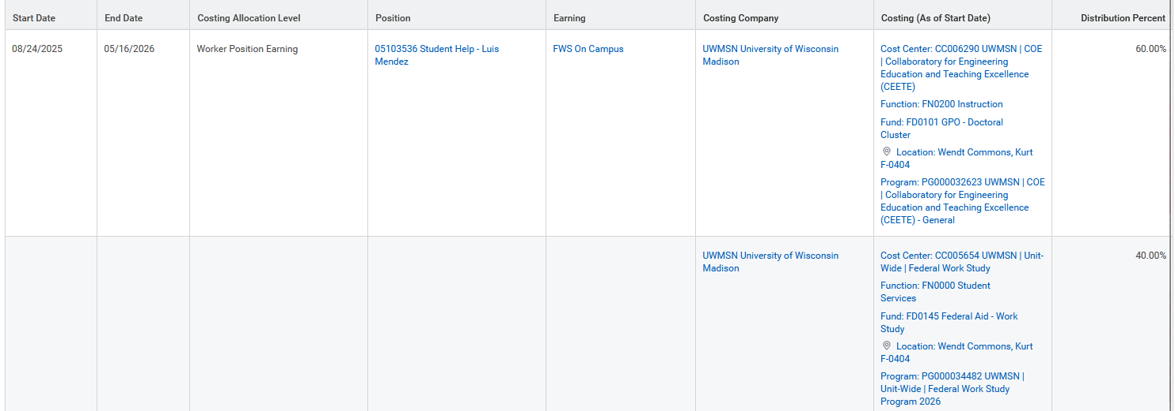
Worker Position Earning
Work Study

Slide 16
Worker Position Earning
Faculty Sabbatical
This is a several step, complicated process.
Work with the Dean’s HR Team to complete all Sabbaticals.

Slide 17
Worker Position Earning
Temporary Work Assignment Supplement (TWA)
HRS/SFS = TWA(TBA) was part of the base salary in the system
Workday = TWA(TBA) is separate from the base salary in Workday
**Currently, when a faculty is on sabbatical, they do not receive any other earnings. We are working with campus to fix this.

Slide 18
Worker Position Earning
TWA Process
Entered in Workday by Dean’s Office HR
Does not go through the “normal” approval process
No Costing Allocation Task in Workday like the Position Restriction and Worker Position Costing Allocations
Includes
  Chair Stipends
  Professorship Elected TWAs (TBAs)
  Temporary duty assignment or role TWA

Slide 19
Worker Position Earning Costing Allocations
Temporary Work Assignment Supplement (TWA)
  Chair Stipends
    Currently these are being charged to the Worker Position Costing Allocations for that faculty.
    TWA Worker Position Earning Costing Allocations need to be added to Workday
  Professorship Elected TWAs (TBAs)
    Dean’s Financial Services Office completed these for FY26
  Temporary duty assignment or role TWA
    Review these on an individual basis to make sure these are created

Slide 20
Worker Position Earning Costing Allocations
TWA Reports
  Worker Allowance Plans (UW)
    Run by Sup Org
    Lists everyone in Sup Org with TWAs as well as the amount
    Does not show if there are Costing Allowances for the TWA
    Current Workers and Jobs with Funds (UW)
      Run by Sup Org
      Lists existing Costing Allocations for employees including Position Restriction, Worker Position, and Worker Position Earning
      Does not show the amount of the TWA

Slide 21
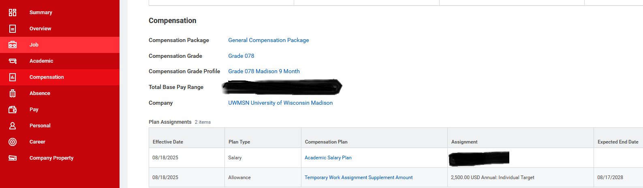
Worker Position Earning
Temporary Worker Assignment Supplement

Slide 22
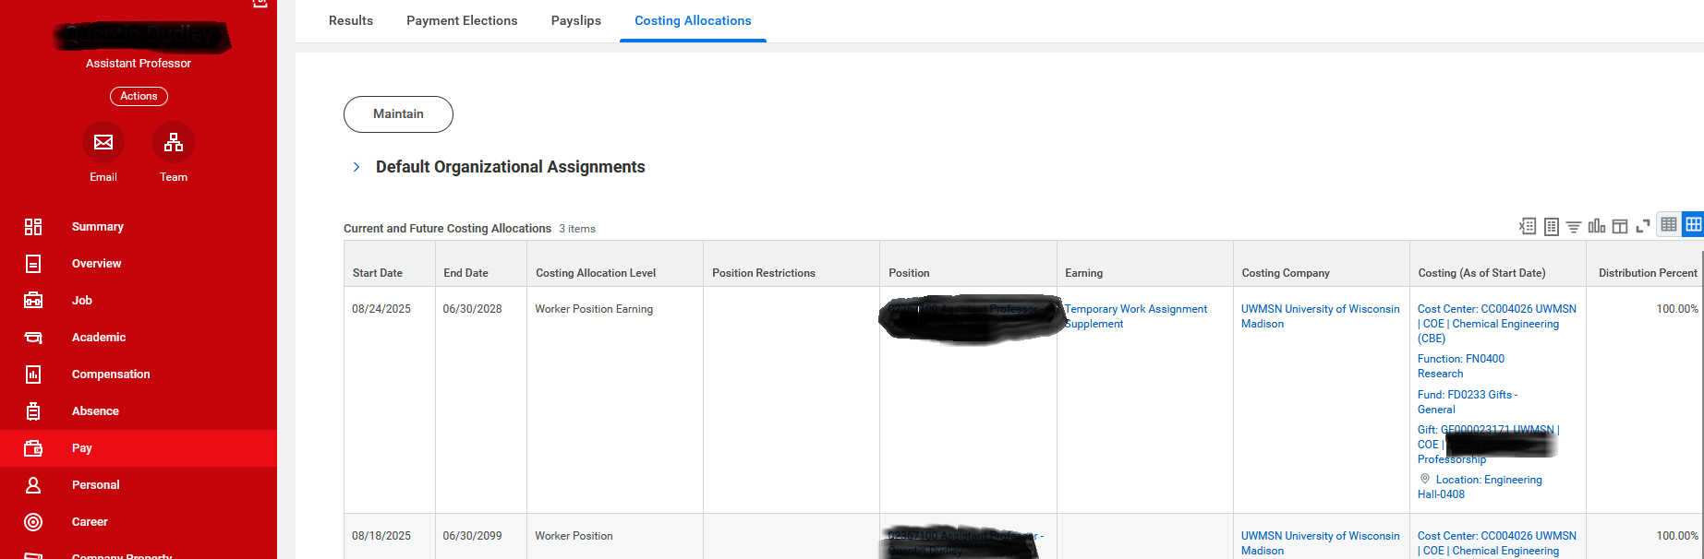
Worker Position Earning
Temporary Worker Assignment Supplement

Slide 23
TO DO
Review the provided report to make sure all TWAs are assigned correctly.
Create Payroll Accounting Adjustments to fix any wrong charges in prior payrolls.
Not covered in detail here but make sure all Sabbaticals are assigned correctly.
Create Payroll Accounting Adjustments to fix any wrong charges in prior payrolls.
Faculty may not have been paid the correct percentage of their salary if these are incorrect. This will require an additional HR process to correct.
Payroll calcs are approximately end of day the Wednesday after the end of the pay period.
Payroll calendars and other resources

Slide 24
Questions/Discussion/ Demonstrations

