Slide 1
Workday Journals
Cost Center Accounting Specialist

Slide 2
Prior CoE Journal Training
This training is a review and assumes you have done journals in Workday.
See Accounting Journal Training (PowerPoint for this training) for a prior training with more basic information. Please remember that some of the details may have changed in Workday. i.e. journal source Manual Journal – With Award Cost is now Manual Journal
Please reach out to our office with any questions coebusserv@engr.wisc.edu

Slide 3
UW-Madison Resources
DoBS Workday Financial Accounting and Pre-Workday Historical Reporting
Great resources for the journal processes
List of Workdays reports at bottom of page
Journal Decision Tree – Located on the above page in a blue box
Make UW-Madison resources priority over System resources when there is a choice.
Using the Workday FDM
SFS Account Code to Workday Revenue / Spend Category Crosswalk
This is your resource for ledger and revenue/spend categories
Note: They are continually making updates to the process at the above web page.

Slide 4
UW System Resources
Create Accounting Journal – Job Aid
Accounting Journals (Manually Entered via EIB Load)
Enterprise Interface Builder (EIB) Library
Scroll down to Finance EIBs
Click the plus by Finance
Two manual journals with and without approvals

Slide 5
Operational Journal Adjustments versus Manual Accounting Journals
In Workday

Slide 6
Manual Accounting Journals are not preferred
Use the Decision Tree to decide if a manual accounting journal is needed.
Only use manual accounting journals if you can’t make adjustment on original transaction (Operational Journals)
Manual Accounting Journals are not connected to original transactions
Must always document well and attach detailed documents

Slide 7
Examples of Original Transactions
(Operational Journal Sources)
Use the Decision Tree to decide if a manual accounting journal is needed.
Payroll Payment or Payroll Accounting Adjustment (Payroll Operation)
Purchase Order or Supplier Invoice (Procurement Operation)
Expense Report or Expense Payment (Expense Report Operation)
Customer Invoice (Customer Invoice Operation)
Customer Payment (Customer Invoice Operation)

Slide 8
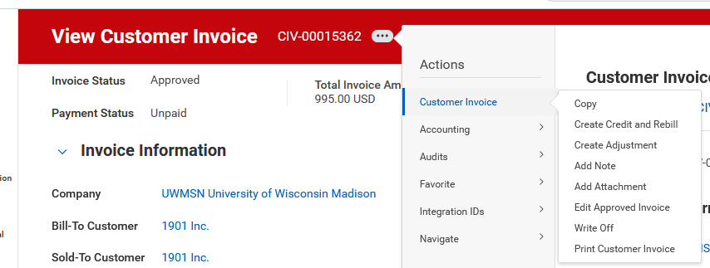
Example of Adjusting Operational Journal

Slide 9
Correct Journal Type
Use the Decision Tree to choose the correct journal type.
Journal Type | When to Use
Manual Journal | When you can use the operational journals or other manual journal types. Also, use this when moving from expense category to expense category (Expense ledger 9999)
Non-Salary Cost Transfer | When you can’t adjust from the operational journal (See decision tree)
Manual Journal - Transfers ONLY | Revenue transfers. Ledger 9000 (Operating Transfers) must be used with this journal source. (Please ask us about this one because some funds have restrictions on what revenue and can be moved in and out of them.)
Payroll Accounting Adjustment (not a manual accounting journal) | This is an operational journal and should be used when making payroll adjustments. Done by Payroll Accounting Adjustment Initiator (UW) Security Role only

Slide 10
Wiser to Workday Transfers
DoBS Workday Financial Accounting and Pre-Workday Historical Reporting
There are specific details and documentation that are unique and required for these submissions. Many of these submission have had this information missing.
Transfer | Journal Type
Non-salary | Submit through Workday Non-Salary Cost Transfer for expenses Manual Journal – Transfer ONLY for revenue Following directions on above page.
Salary | Email to DoBS journals@bussvc.wisc.edu Follow directions on the above page to prepare documents to submit via email.

Slide 11
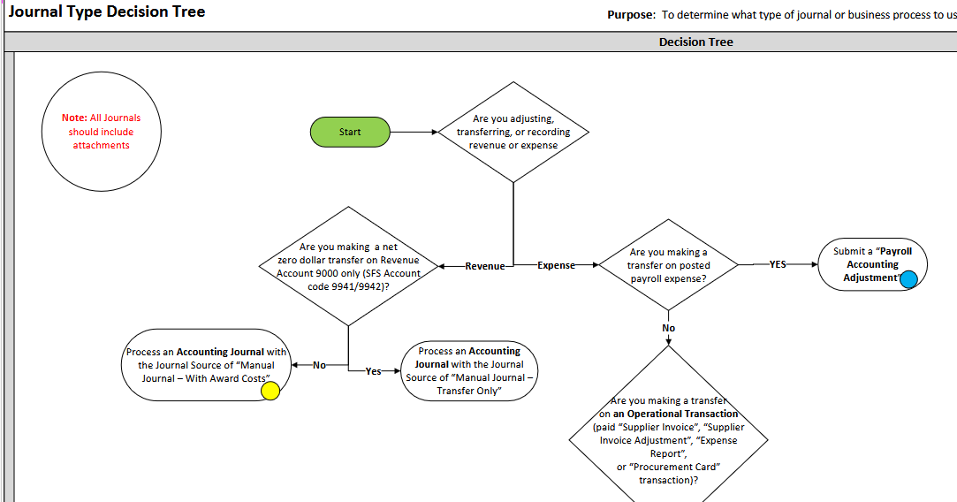
Journal Type Decision Tree
If you are unsure of which journal to submit, use the Journal Type Decision Tree
The tree will indicate when to adjust the operational journal or create a manual accounting journals.

Slide 12
Common Errors in Manual Journals
In Workday

Slide 13
Revenue/Spend Categories
Reference this spreadsheet for the most up to date information
If a revenue or spend category has the word “conversion” in it – do not use it.
These will be in red and say DO NOT USE next to them in the spreadsheet.
These should be inactive in Workday now.
The “conversion” revenue/spend categories were only for the conversion from Wiser to Workday – they were not for our use.

Slide 14
Ledgers and Revenue/Spend Categories
Reference this spreadsheet for the most up to date information
Always use a revenue category with a revenue ledger
Always use a spend category with a spend ledger
These are on separate tabs in the above spreadsheet

Slide 15
Revenue/Spend Category Missing
It is easy to forget the revenue or spend category
These fields are located between the driver worktags and the rest of the worktags – easy to miss
The ledger 9999 is a spend ledger so use a spend category with this ledger (SC00605)

Slide 16
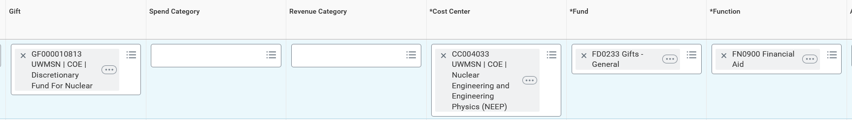
Incorrect Auto Populated Worktags
When driver worktag is added the other worktags auto populate with the defaults.
Must verify that these are the ones you want to use.

Slide 17
Wiser to Workday Transfers
Missing specific reference to Wiser and Workday transition information
Missing attachments of Wiser information
Please follow the instructions on this page carefully
Please reach out to our office for assistance with these.

Slide 18
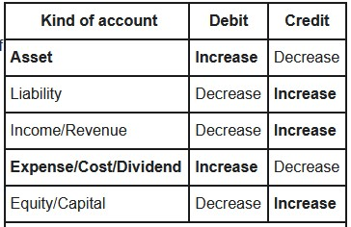
Debit versus Credit

Slide 19
Missing Attachments
These are required just like they were in Wiser
They assist historically and in case of an audit
You can go back and add your attachments as long as the journal has not been approved by any of the approvers.

Slide 20
Finding Created Journals

Slide 21
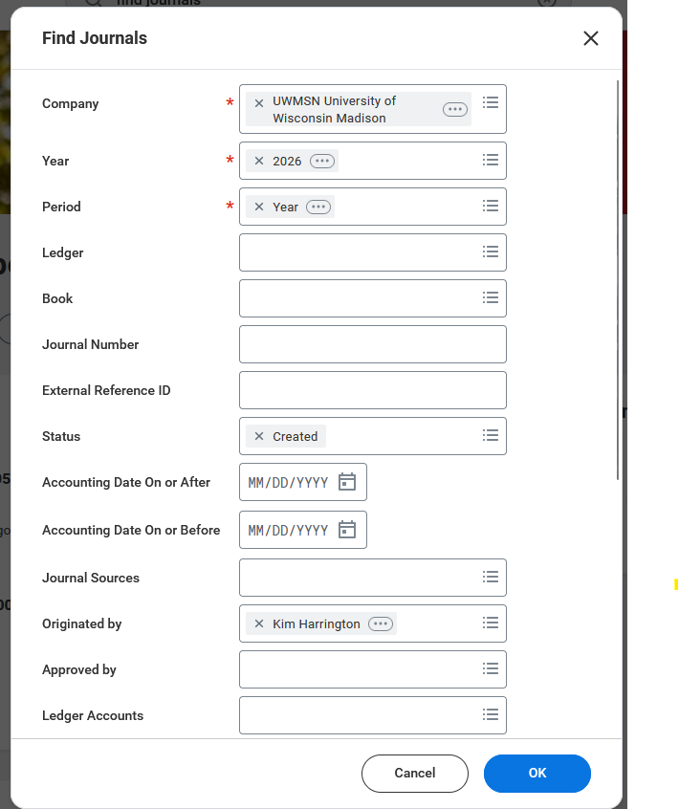

Find Journals

Slide 22
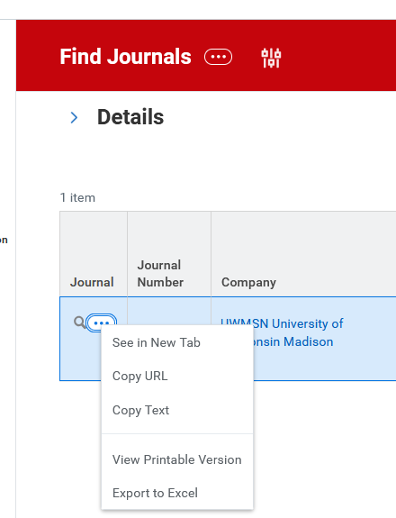
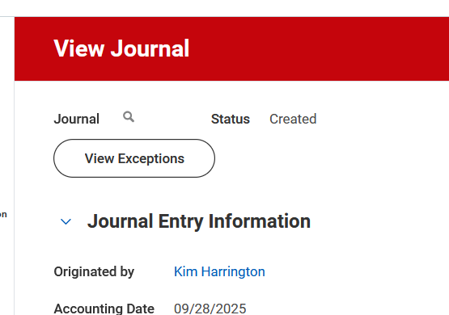

Edit Journal

Slide 23
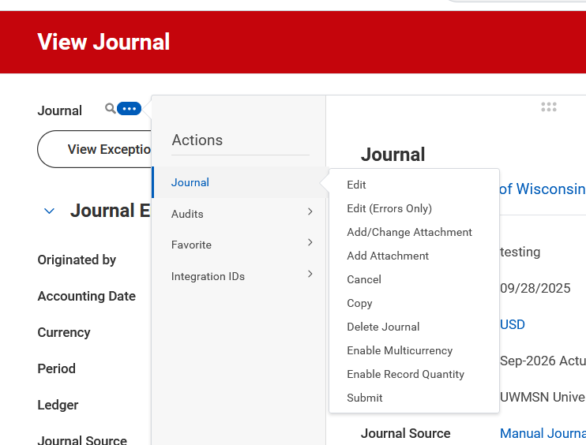


Edit Journal

Slide 24
We are here to help

Slide 25
Created Journals
Reach out to us for assistance
We are happy to meet with you to work through your journals
You can create your journal, save it for later and reach out to us
We can review it before you click submit
Caution – Please Remember
Journals are only approved by the Worktag Manager and then get posted
The initiator and Worktag Manager are the only ones that review each manual journal
After the journal is posted we recommend you check that posted correctly in your worktag(s).

Slide 26
Cash-Basis Accounting to Accrual-Basis Accounting
Finance@UW - Accrual Accounting - Prepare for accrual accounting (self-paced)
A self-paced learning experience has been developed to guide you through the core components of accrual accounting and how it differs from cash-basis accounting (commonly used in the former system across the UW). This course includes numerous opportunities to engage with clear examples that represent financial transactions from all over our campus.

Slide 27
Questions

