Slide 1
External Customer Accounts
Customer Billing Specialist
Notes:
External Customers do not include other university in the UW System. Those are internal customers and will be included in next weeks Internal Services Delivery training for those of you who have the security role Internal_Catalog_Data_Entry_Specialist and/or Internal_Service_Delivery_Data_Entry_Specialist. You should have that training on your calendar next Tuesday from 1 pm to 2:30 pm.

Slide 2
Reports for Customer Accounts
Find Customers with Facet Search
EIB Customer Data (UW)
EIB Sales Item Data (UW)
Find Customer Invoices for Company
Find Customer Payments
*View Customer – To look at the information for one customer
Notes:
EIB reports give you the “Integration ID”. Customer ID and contact ID
I found two dashboards. One for customer accounts and one for customer accounts and ISD

Slide 3
Processes for External Customer Accounts
Request new Sales Items
Request new Customers
Request new/edit Contacts or Addresses
Create Customer Invoice
Create Invoice Adjustment
Cancel and Rebill Customer
Write Off Invoice
Customer Refund
Interest & Late fees
Notes:
Won’t be going over the customer contracts that security role Customer Contract Specialist can set up and process. We only have six customer contract specialist in CoE and two our in the Dean’s Business Office.

Slide 4
Tasks and Requests

Slide 5
Tasks for External Customer Accounts
Create Customer
Create Customer Invoices for Company
Find Customer invoices for Company and navigate to the three dots to Create Adjustment or Create Customer Invoice Adjustment
Find Customer invoices for Company and navigate to the three dots to Create credit and Rebill
Write Off Customer Invoice
Notes:
Fill in fields in Tasks

Slide 6
Create Requests
for External Customers Accounts
Customer Refund
Sales Item
Request or Edit Customer Contact (this is where you can also edit the address.)
Notes:
Text form that is submitted for campus to enter in and process

Slide 7
Enterprise Interface Builder (EIB)

Slide 8
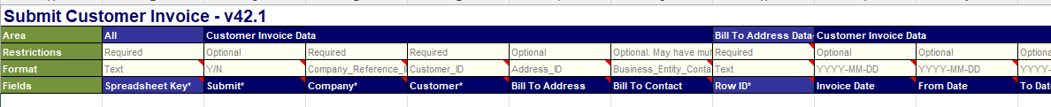
EIB –Enterprise Interface Builder
EIB is a mass upload for several lines
i.e. invoices, customers, contacts
Replaces entering each line individually in Workday
There are different EIBs for different Workday processes

Slide 9
EIB Notes
Columns in the row represent field in Workday
Not all cells have to be filled in
EIB is validated in Workday
When there are no errors then it is uploaded

Slide 10
Enterprise Interface Builder (EIB) Library
Process | EIB Template | EIB Job Aid
Create Customers | Submit Customer Inbound | Submit Customer Inbound EIB Template
Request new/edit Contacts | Put Customer Contact Inbound Template | Put Customer Contact Inbound EIB Template
Request Sales Items | Put Sales Item Inbound Template | Put Sales Item Inbound EIB Template
Create Customer Invoices | Submit Customer Invoice Inbound | Submit Customer Invoice Inbound EIB Template
Create Customer Invoice Adjustment | Submit Customer Invoice Adjustment Inbound Template | Submit Customer Invoice Adjustment Inbound EIB Template
Loading an EIB

Slide 11
EIB Assistance
We will have samples on the CoE Workday Intranet for each EIB with the required fields filled in with sample data and highlighted in yellow.
Can’t rely on the “required” in the EIB field headers.
Always download a new EIB from the EIB Library in case there have been any changes.

Slide 12
Questions & Discussion
Notes:
Bring questions on Friday as well. We will have time on Friday to talk through questions. We will also be learning more on Friday. The second half is not just a Q&A session.

Slide 13
Customer and Sales Items
Notes:
Existing information in Workday.

Slide 14
Find Customer & Contact and Sales Items in Workday
EIB Customer Data (UW) – Has contact Integration IDs listed
EIB Sales Item Data (UW)
Notes:
Many of our customers and sales items are in Workday already. Run a list to review.
View customer CUS0002381 to show how to see the integration ID for a customer in red header. Also, has several contacts with one being the primary.

Slide 15
EIB Demonstration

Slide 16
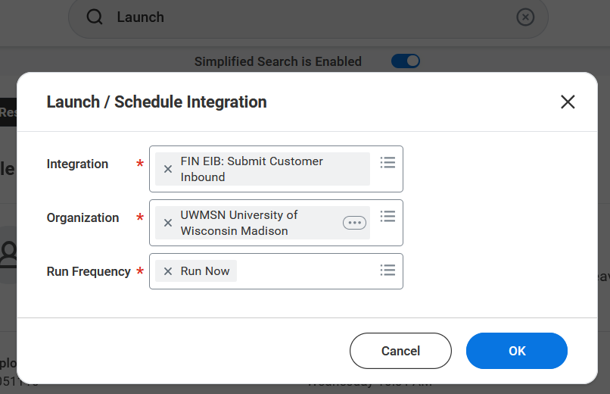
Launch in Workday
The below example is for the create customers EIB

Slide 17
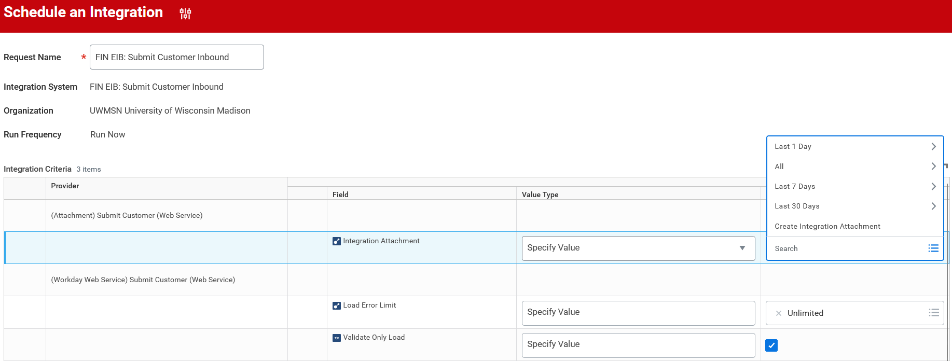


Validate in Workday
Check the highlighted box to validate
Choose Create Integration Attachment
On the page that opens in Workday, upload your EIB

Slide 18
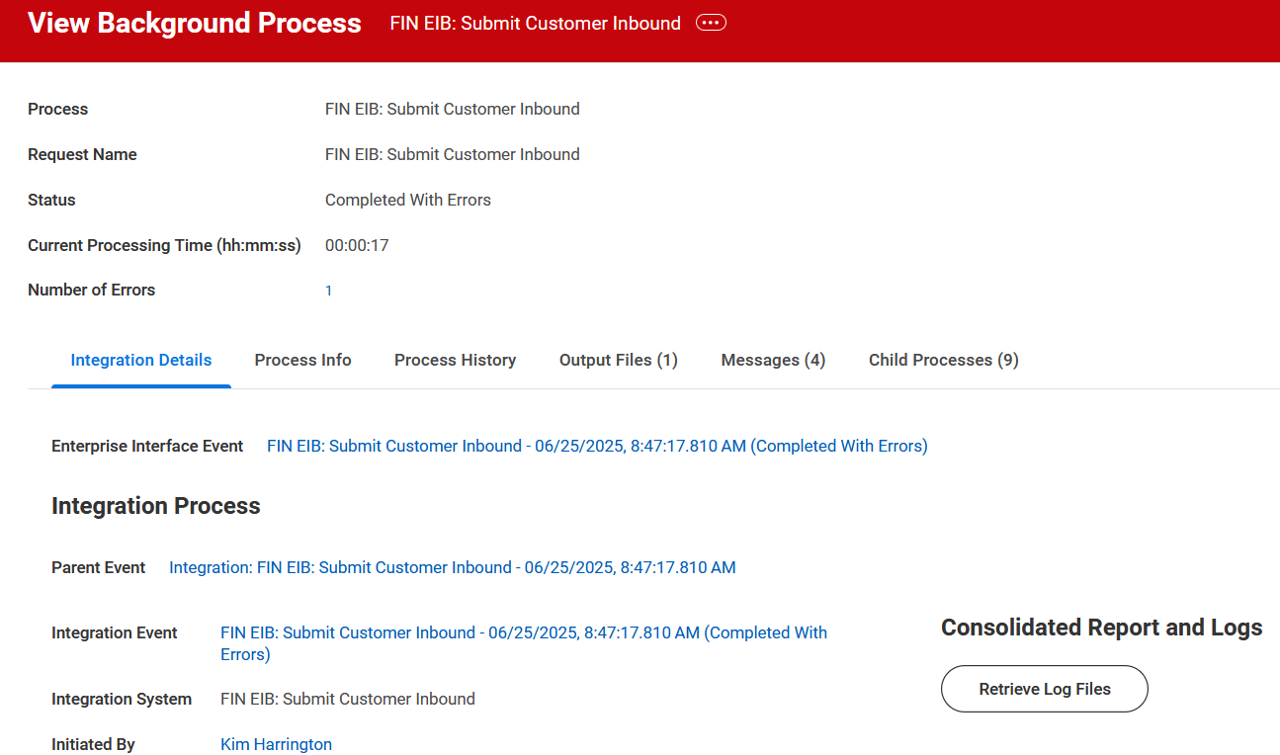
Check for Errors
After you upload click ok twice
A process page opens.
Click Refresh until it says completed
It will say completed with errors if there are errors to correct

Slide 19
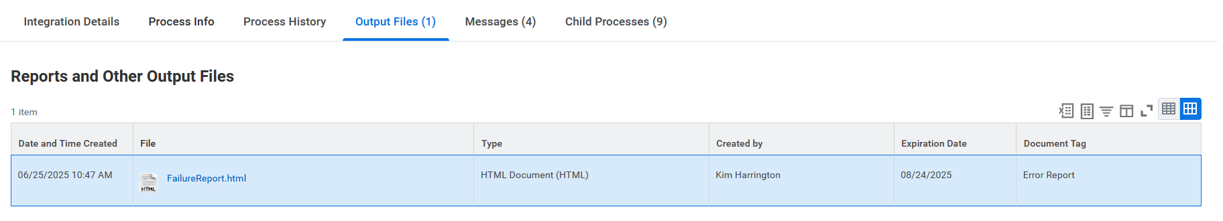
Reviewing Errors
Click Output Files
Open the Failure Report
This will tell you the name of the field that has the error
Fix the error and run the validation again.

Slide 20
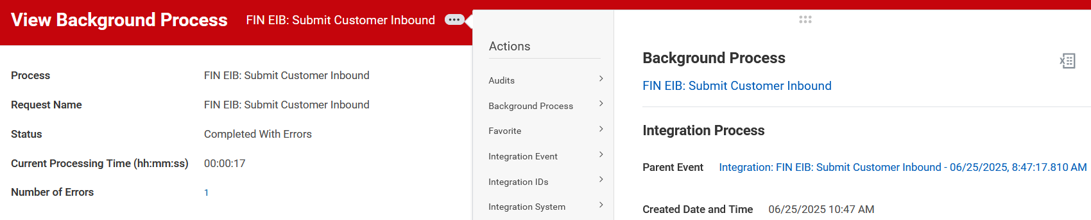

Rerunning Validation
To run the validation again.
Click the three dots by the View Background Process.
Hoover over Integration Event.
Choose Relaunch Integration Event.

Slide 21
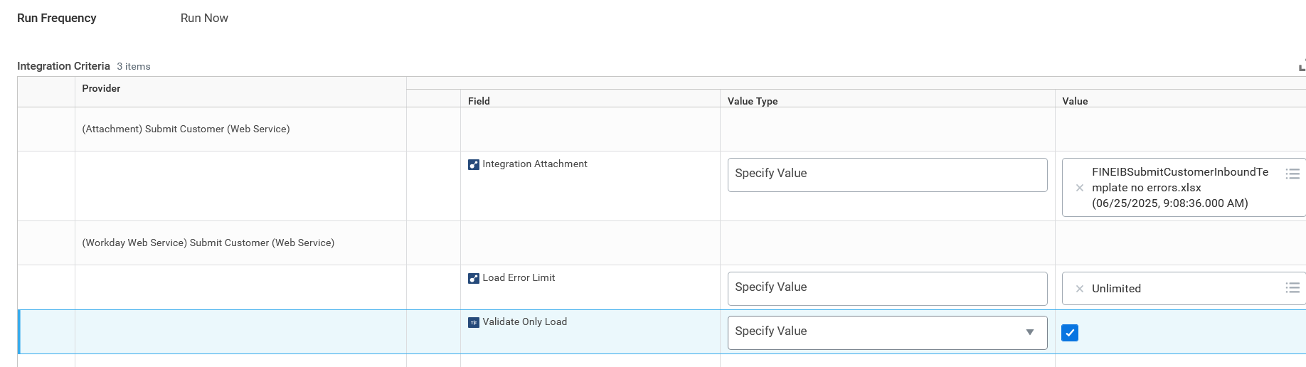


Rerunning Validation and uploading EIB
Remove the file from the page and upload your file again.
Once you have corrected all errors and you are ready to upload the EIB uncheck the box you checked previously.

Slide 22
View your submission
Go to your tasks Archive to view the data load message.
Many of the external customer processes will route to central for review and completion.

Slide 23
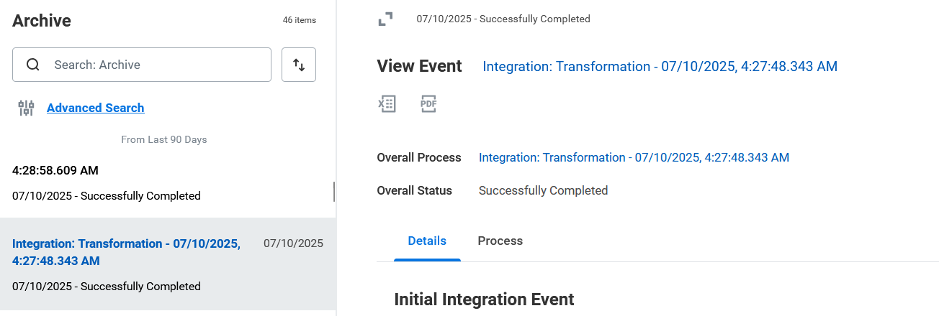
Validation Task
The validation will be in your Task Archive
It will be titled, “Integration: Transformation

Slide 24
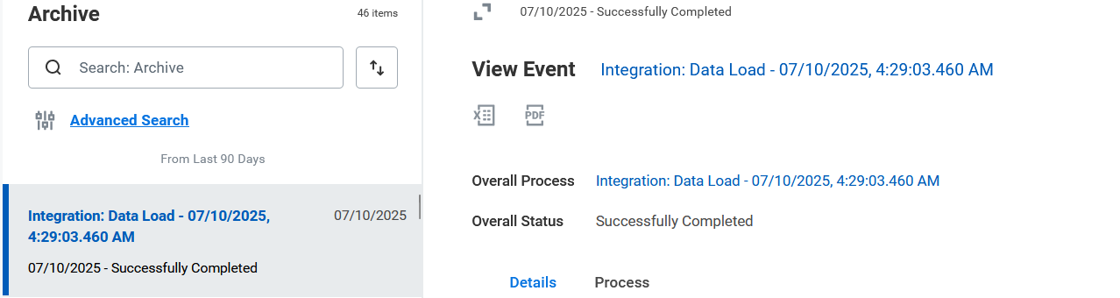
Submission Task
The validation will be in your Task Archive
It will be titled, “Integration: Data Load

Slide 25
Friday Meeting
Practice if you can before Friday.
Bring your questions and issues.
After your questions we will do more EIBs.
*Some of you will also be invited to our Internal billing trainings.
Those will be the same concept but a whole new way for us to think of internal billing.

Slide 26
Day 2 Customer Accounts

Slide 27
Questions and Discussion

Slide 28
Follow up Notes
When creating a new customer you will need a company email.
i.e. – accountspayable@company.com
You can add your specific person contact as a second email contact.

Slide 29
EIBs Continued
Process | EIB Template | EIB Job Aid
Create Customers | Submit Customer Inbound | Submit Customer Inbound EIB Template
Request new/edit Contacts | Put Customer Contact Inbound Template | Put Customer Contact Inbound EIB Template
Request Sales Items | Put Sales Item Inbound Template | Put Sales Item Inbound EIB Template
Create Customer Invoices | Submit Customer Invoice Inbound | Submit Customer Invoice Inbound EIB Template
Create Customer Invoice Adjustment | Submit Customer Invoice Adjustment Inbound Template | Submit Customer Invoice Adjustment Inbound EIB Template

Slide 30
Requesting a Sales Item
Create Request for Sales Item additions
Refer to the sample EIB on the job aid to fill out the EIB
Notes:
Cash Sale Payment Specialists can also request new sales items but not new Sales Item Groups.

Slide 31
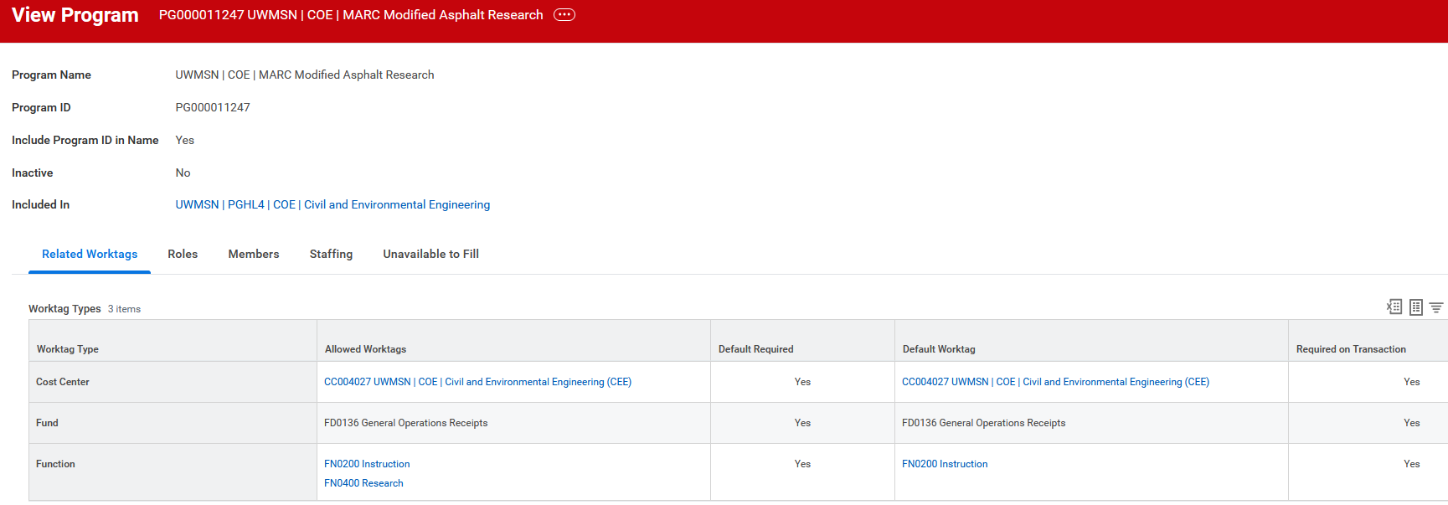
Sales Item EIB Notes
Finding Worktag defaults
Search the worktag in Workday
Click on the worktag

Slide 32
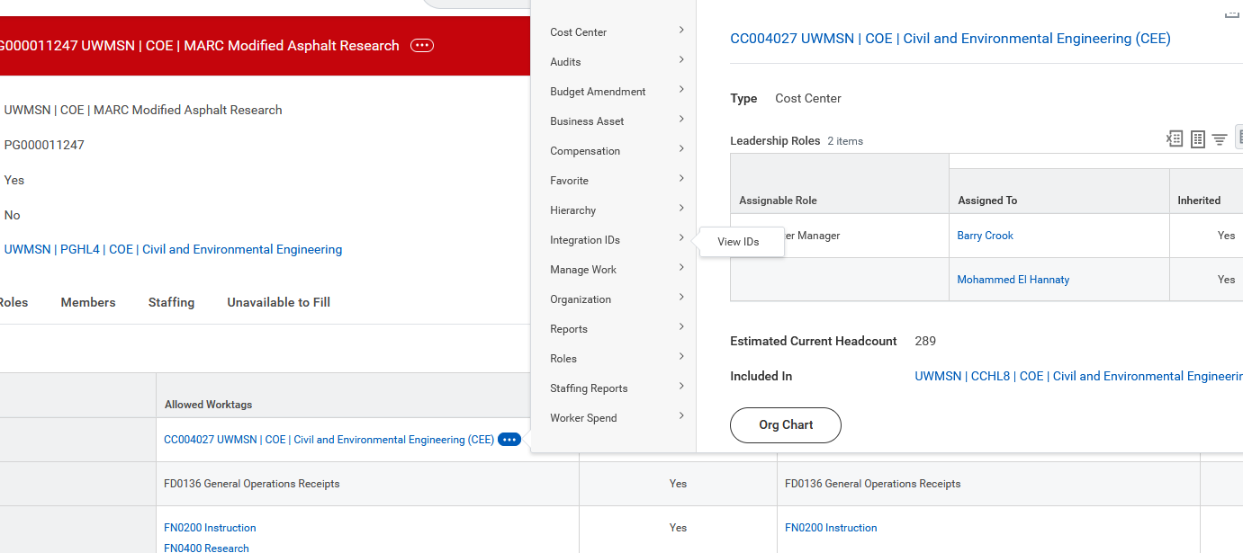

Sales Item EIB Notes Continued
Finding Worktag defaults
Click on three dots next to the worktag type you are looking for.
Choose Integration IDs and click on View IDs

Slide 33
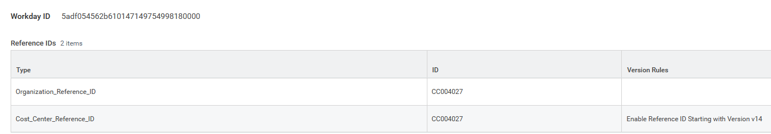

Sales Item EIB Notes Continued
Finding Worktag defaults
You will find the Type Integration ID to add to the EIB.
There are two listed below. The bottom one is the correct one.

Slide 34
Customer Invoices EIB Notes
Follow the Job Aid and our example on the Workday CoE Intranet.
Options for these columns
Column C (Submit) – Y = submission; N = draft and you will have to submit later (See following slides)
Column F – leave blank to use the default address
Column Q and AG are memos that will show up on the invoice
Column S – You can add numbers in this column if you have more than one line and want them in a specific order on the invoice

Slide 35
Draft Invoices Upload Option

Slide 36
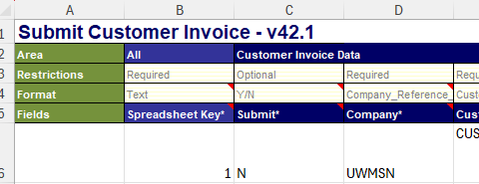


Draft invoice Upload
If you choose to not submit your upload it will be in Workday in draft form.
Notes:
This will not be a preferred way because you will have to find each customer and submit the invoices that are in draft form.

Slide 37
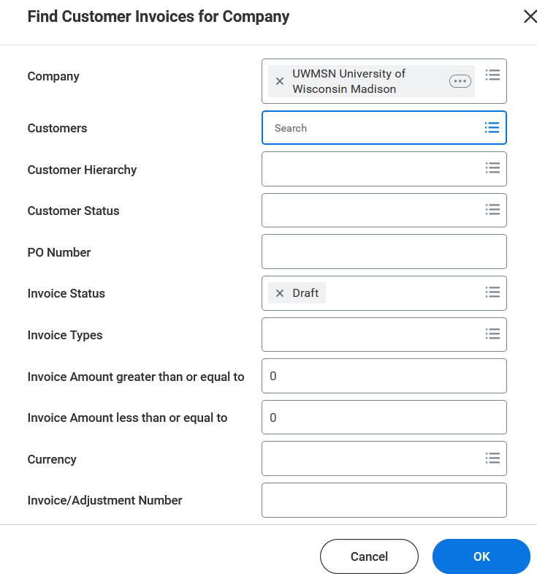
Find Invoice draft
Find Customer Invoice by Company
Company = UWMSN
Customer = Customer ID from EIB
Invoice Status = Draft

Slide 38
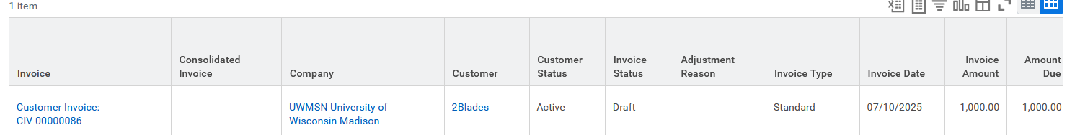

Find Customer Invoice
Under Customer invoice by the three dots, choose Customer Invoice.
The below screenshot does not show the three dots, but they will appear when you hover by the customer invoice number.

Slide 39
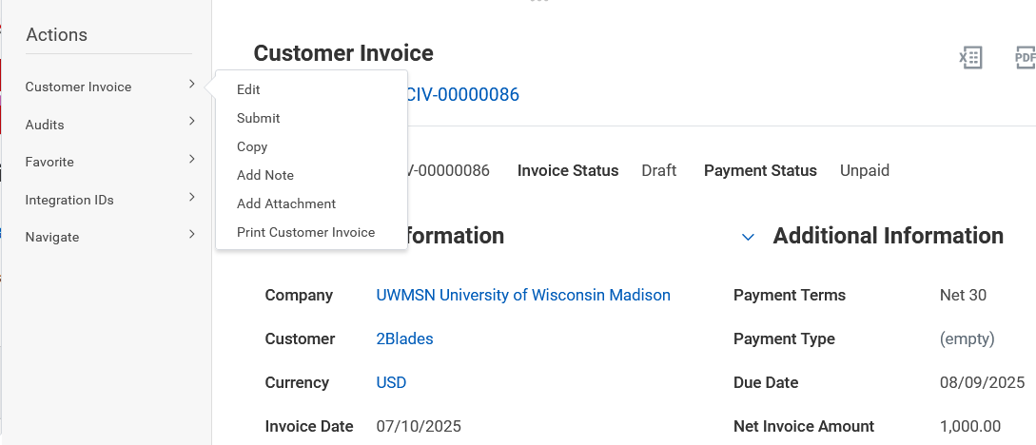
Submit or edit Customer Invoice
On the left there is a drop-down menu next to Customer Invoice.
You can Edit or Submit from here.

Slide 40
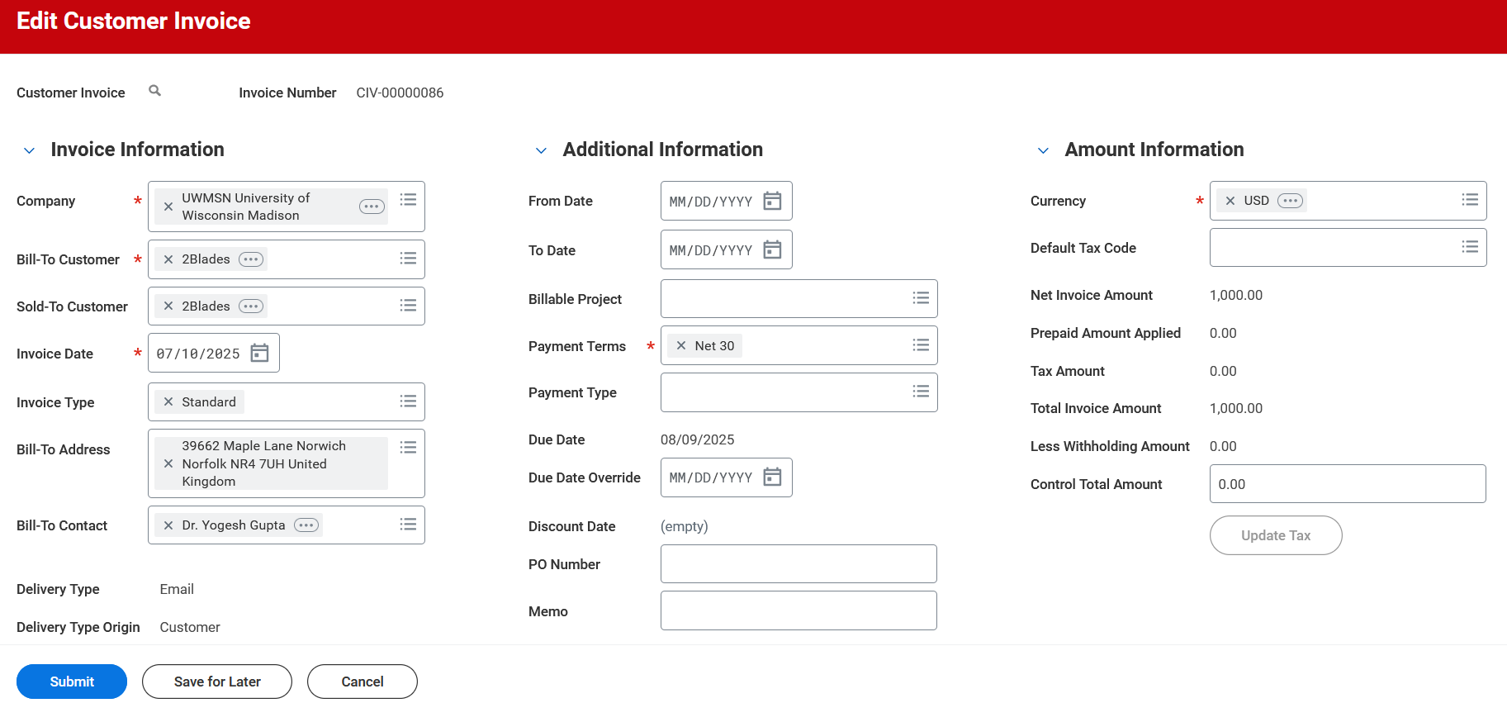
Edit Customer Invoice
Allows you to make changes before you submit.

Slide 41
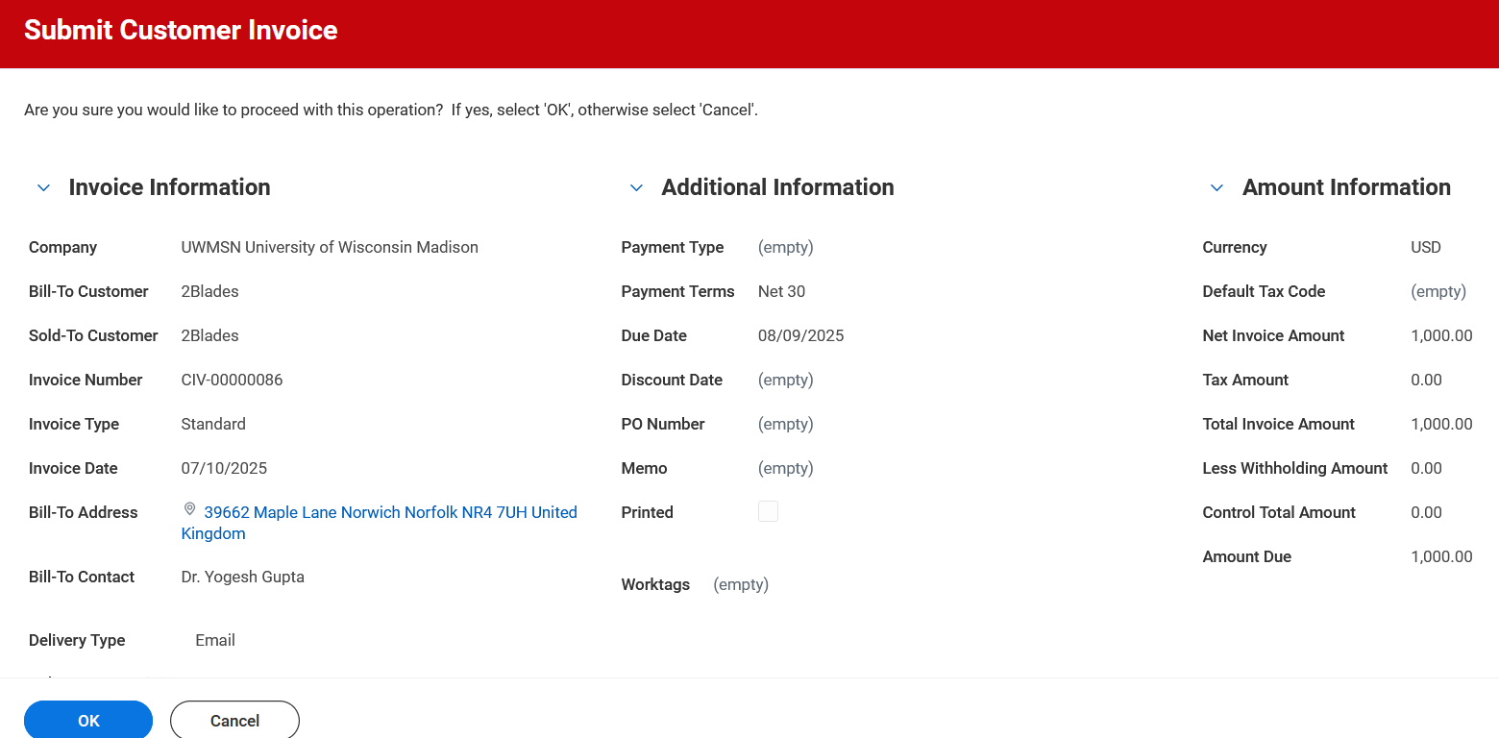
Submit Customer Invoice
Allows you to view the invoice and submit.

Slide 42
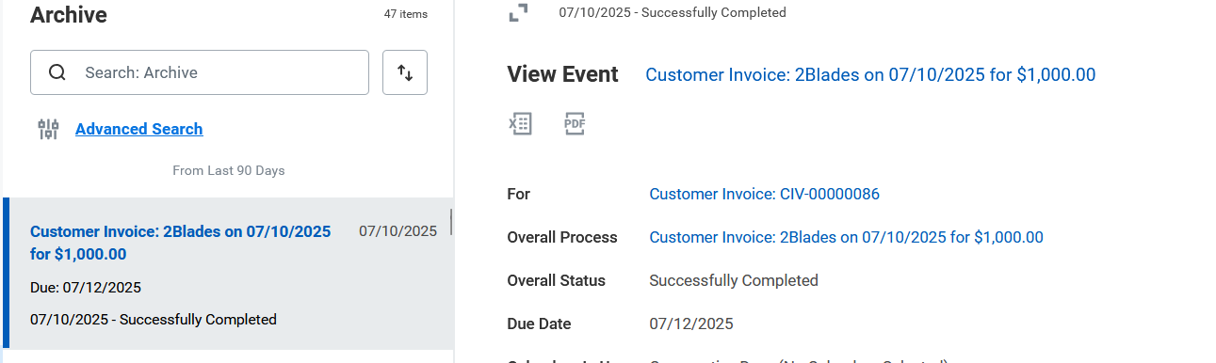
Customer Invoice Task
You will find a task in your archives for the submission.

Slide 43

View Customer Invoice
To see the invoice the customer receives.
Click the three dots next to the For Customer Invoice #

Slide 44
View Customer Invoice
From the pop-up window hover on the drop-down arrow next to Customer Invoice on the let side.
Chose Print Customer Invoice at the bottom of the list.

Slide 45
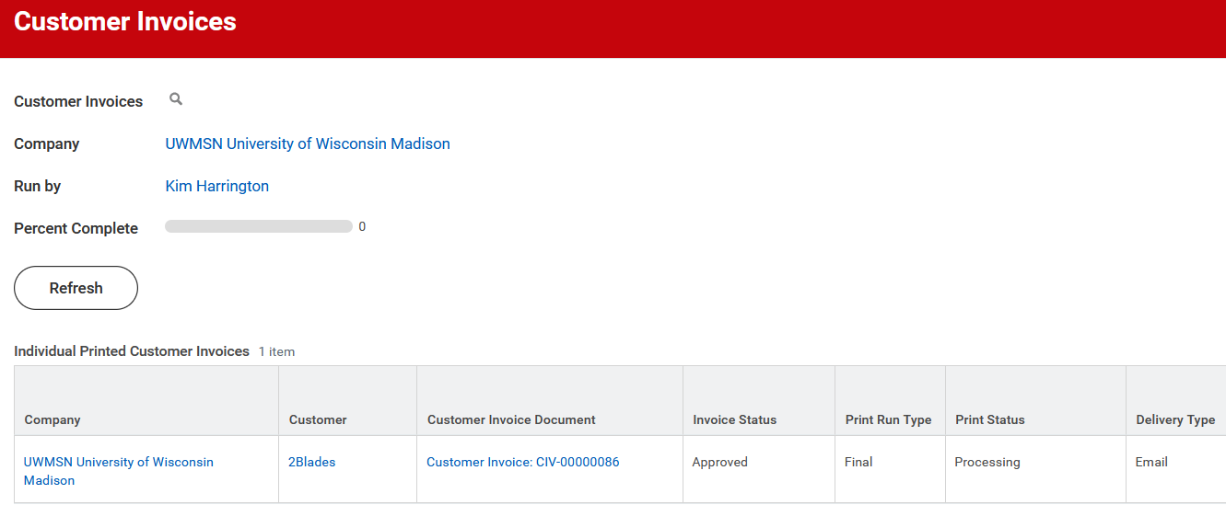
View Customer Invoice
You can refresh this page until it is complete.
You will then see a download of the invoice itself.

Slide 46
Questions and Discussion

