Slide 1
Costing Allocations
Payroll Accounting Adjustments
  Cost Center Accounting Specialist
  HR Process Coordinator (Supervisory) UW
  Position Budget Manager
  Payroll Accounting Adjustment Initiator UW

Slide 2
Costing Allocation = Salary Funding String
Position Restriction
Worker Position
Worker Position Earning
Costing allocation assigned to position
Costing allocation assigned to individual in position
Costing allocation for additional pay compensation options
Default costing allocation - CoE is assigning these to program worktags
This won’t be covered in this session because it is an HR process *
* Cost Center Accounting Specialist is in the approval chain of this process.

Slide 3
Position versus Employee
Former (HRS) System versus Workday
HRS
Workday
Position attached to person. When person resigns position is gone.
New position created with every new hire.
Position is created once and exists as long as the FTE is fillable. When person resigns position remains for next hire.
New hire fills existing position.
* Role-based security roles stay attached to the position and will be assigned automatically to the new hire.

Slide 4
Processes in
Former (HRS) System versus Workday
Former
Workday
Budget Funding Data Entry
– HRS
Salary Cost Transfer
– Cost Transfer Tool
Assign Costing Allocation
Payroll Accounting Adjustment (PAA)

Slide 5
Job Aids
Assign Costing Allocation – Before payroll is processed
  Cost Center Accounting Specialist, HR Process Coordinator (Supervisory) UW, Position Budget Manager
Payroll Accounting Adjustment – After payroll is processed
  Payroll Accounting Adjustment Initiator UW
  Assign Costing Allocation for Work Study
  Cost Center Accounting Specialist, HR Process Coordinator (Supervisory) UW, Position Budget Manager
  Earnings Codes
    Includes: Tip Sheet - HRS to WD Earnings Code Crosswalk

Slide 6
Reports for Costing Allocations
Current Workers and Jobs with Funding (UW) – Position Restrictions, Worker Positions, and Worker Position Earnings
All Workers Costing Allocations by CCHL, Company, Sup Org or Worker (UW)
Extract Worker Costing Allocations (UW) – view worker's wholistic costing allocation information
All Workers Costing Allocations by Company, Sup Org or Worker (UW)
All Position Restrictions Costing Allocations by CCHL, Company, Supervisory Org and Position (UW)
Workers with Expired or Invalid Costing Allocations (UW)
Extract Workers Missing Costing Allocations (UW)
Workers with Expiring Grant Costing Allocations (UW)
Payroll Accounting 360 (UW)
*Individual employee costing allocation – view profile
Notes:
During the conversion grant end dates of costing allocations were set at 6/30/26. We can talk about how to address this if we have time.

Slide 7
Questions
Notes:
STOP

Slide 8
Assign Costing Allocations
  Cost Center Accounting Specialist
  HR Process Coordinator (Supervisory) UW
  Position Budget Manager

Slide 9
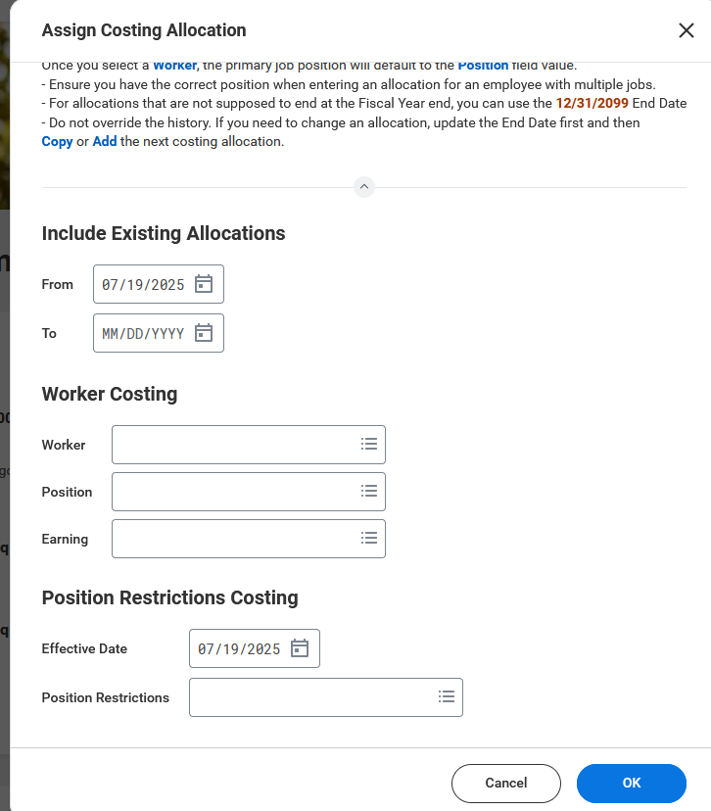
Assign Costing Allocation
Worker Position
Worker = Worker Name
Position = If correct position is not listed click on X, click in box and choose correct position
NOTE: Earning is used when changing the extra pay options costing allocation
Position Restriction
Position Restriction = Position number or worker name of person who currently holds position

Slide 10
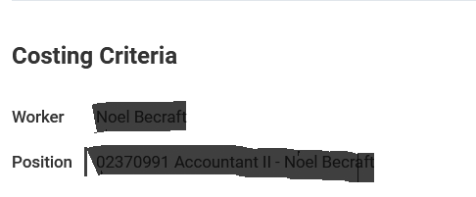
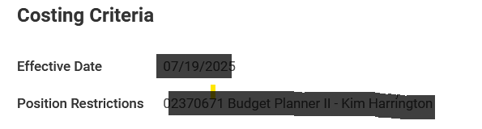
Assign Costing Allocation
Position Restriction
Worker Position

Slide 11
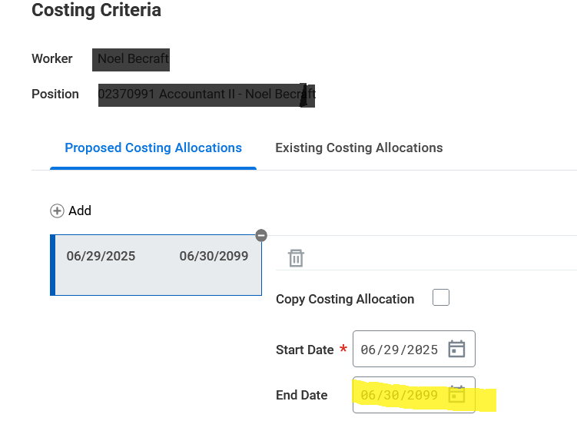
Worker Position Costing Allocation
Change the end date of the current costing allocations.

Slide 12
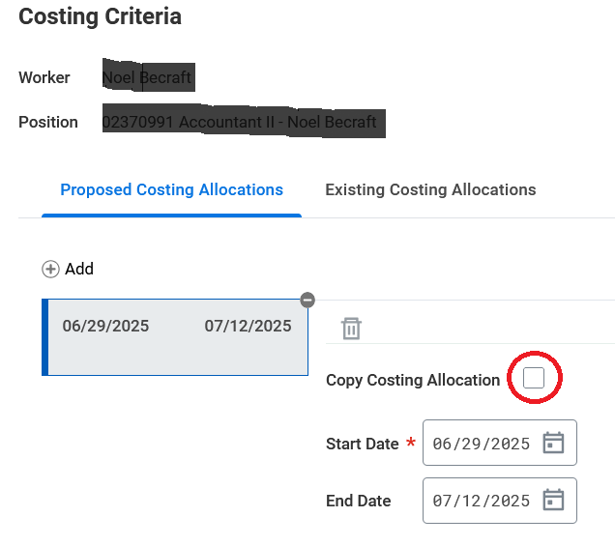
Worker Position Costing Allocation
Click the Copy Costing Allocation box

Slide 13
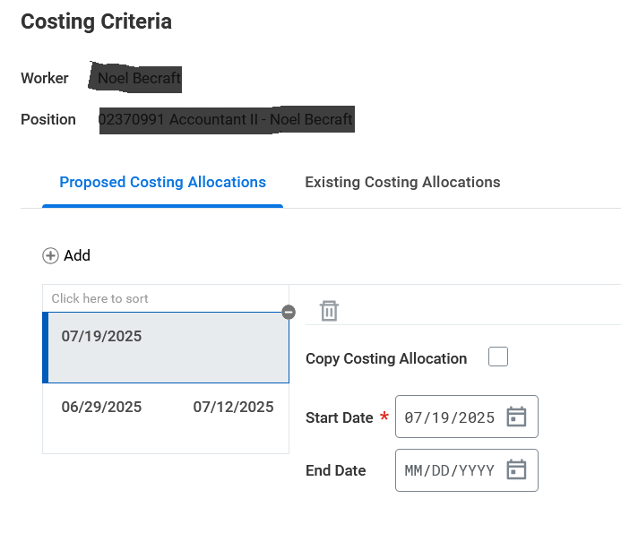
Worker Position Costing Allocation
You will now see two costing allocations listed.
Make sure the start date is the date after the last end date.
Add your end date.

Slide 14
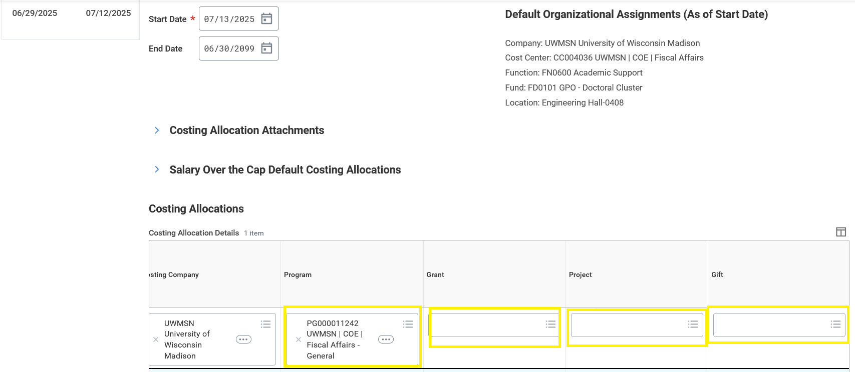
Worker Position Costing Allocation
Add your new worktag in the Costing Allocations Detail.

Slide 15
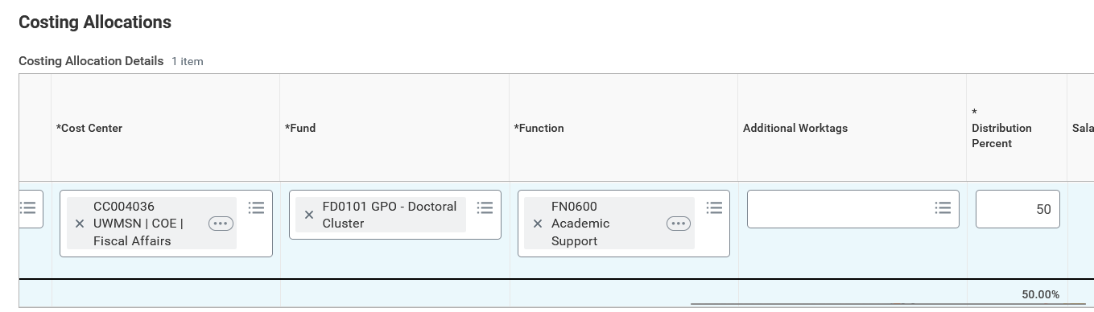
Worker Position Costing Allocation
If you need to split the costing allocation. Add the % on the right end of this line.

Slide 16
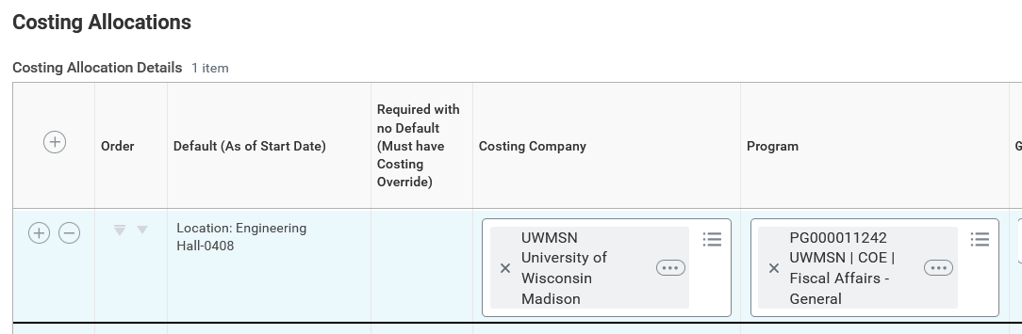
Worker Position Costing Allocation
Then click the plus sign on the far left to add another line for another worktag.
Add the other worktag and the % on this line.
Do this until you have all your worktags entered and your distribution is 100%. Workday will automatically populate the percent as you go to equal 100%.

Slide 17
Payroll Accounting Adjustment (PAA)
  Payroll Accounting Adjustment Initiator UW

Slide 18
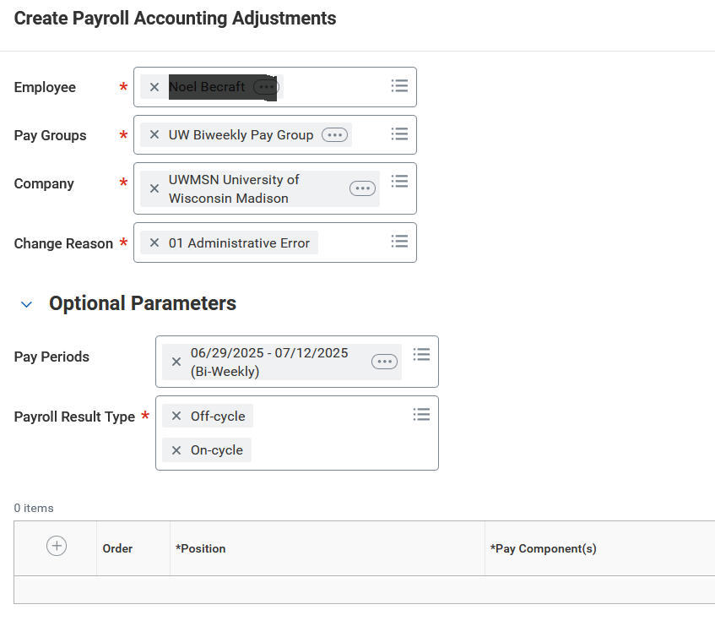
Create Payroll Accounting Adjustments
Fill in header fields
Choose pay periods you want to change

Slide 19
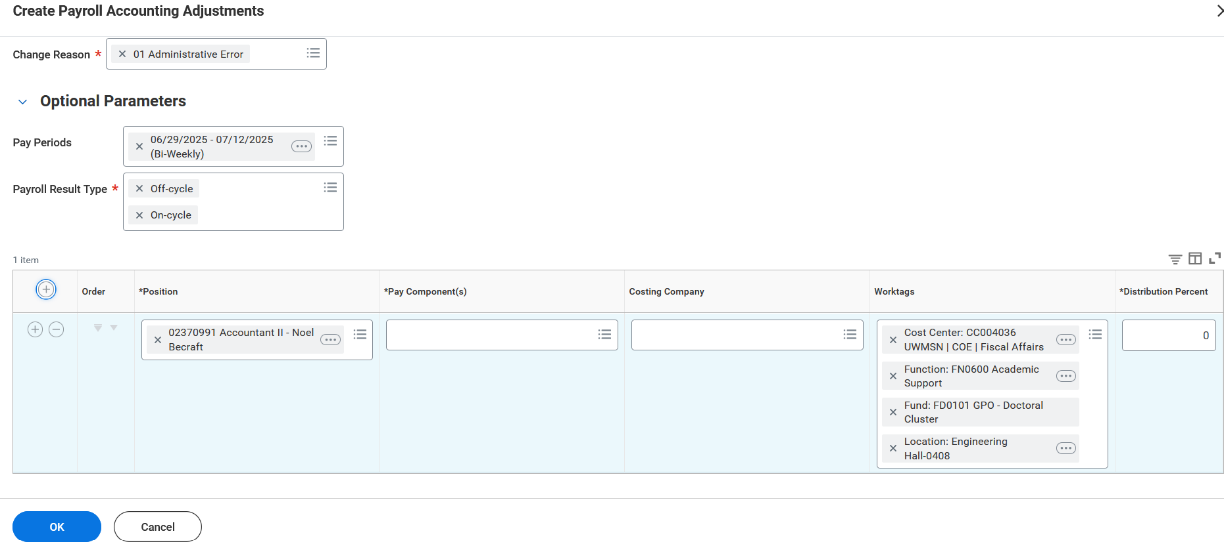
Create Payroll Accounting Adjustments
Click the plus if you want to distribute the funds by percentage.
Click ok if you want to distribute by dollar amount.

Slide 20
Questions & Discussion

Slide 21
Future Trainings
Pre-Workday Payroll Adjustments
Pre-Workday Non-Salary Adjustments

