Slide 1
Workday Journals
Cost Center Accounting Specialist
Notes:
Will include the pre-Workday non-salary transfer process. This is the same as the EIB upload process except for some wording changes in the EIB.

Slide 2
UW-Madison Resources
DoBS Workday Financial Accounting and Pre-Workday Historical Reporting
Great resources for the journal processes
List of Workdays reports at bottom of page
Journal Decision Tree – Located on the above page in a blue box
There are links to both UW-Madison and System Job Aids and resources on this page.
Make UW-Madison resources priority over System resources when there is a choice.
Note: They are continually making updates to the process at the above web page.

Slide 3
UW System Resources
Create Accounting Journal – Job Aid
Accounting Journals (Manually Entered via EIB Load)
Enterprise Interface Builder (EIB) Library
Scroll down to Finance EIBs
Click the plus by Finance
Two manual journals with and without approvals

Slide 4
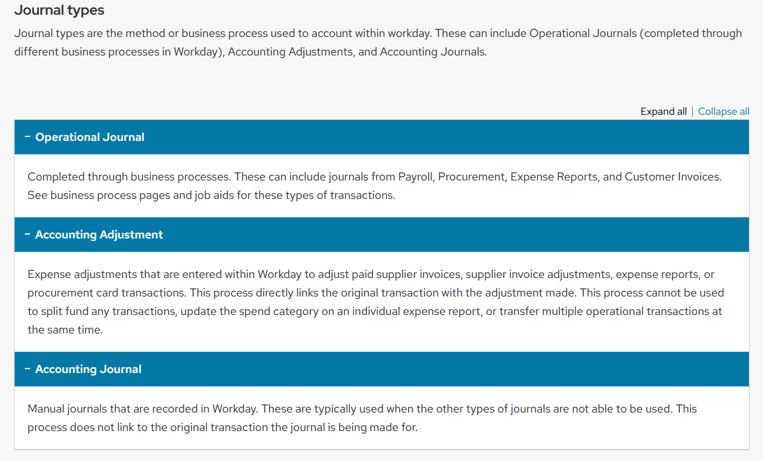


Journal Types

Slide 5
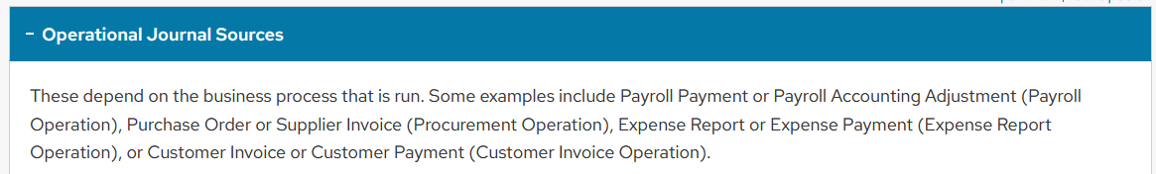
Journal Source
Journal sources identify the origin of a journal posted in Workday. In operational journals, such as payroll, procurement, expense reports, or customer invoices, the journal source is automatically generated. In manual journals, journal sources are user defined. Journal sources can be filtered on in Workday, to help analyze financial data.

Slide 6
Journal Sources Descriptions
Journal Source | Description
Manual Journal - With Award Cost | Standard manual journal source that should be used. This allows Award Cost Processing in the event a grant worktag is used.
Non-Salary Cost Transfer | Journal Source to be used when processing Non-Salary Cost Transfers when the Workday Accounting Adjustment cannot be used. Use cases would be if a portion of an expense needs to be transferred or multiple expenses need to be transferred at the same time.
Manual Journal - Transfers ONLY | Journal source to be used for operational revenue transfers. Ledger Account 9000 (Operating Transfers) must be used with this journal source.
Manual Journal - XJV | Journal source for miscellaneous transfers with no DOA output for UW System use only.
Manual Journal - XML | Journal source for master lease journals with no DOA output for UW System use only.
Manual Journal - Year End Adjustments | Journal source replacing Period 998 journals. Journals to this source must be reviewed by UW System prior to posting.
Manual Journal - No Award Costs | Journal source for Research Administration to make adjustments to grants that should not process award costs.
Manual Journal - Cost Share Only | Journal source for Research Administration to record Cost Share Facilities & Administration expenses, Third Party and Waived Facilities & Administration Cost Share entries.
Manual Journal - F&A Adjustments | Journal source used by Research Administration to make changes to the F&A expense/revenue posted to a grant.
Residual Balance Transfer | Journal source for Research Administration to transfer the remaining cash balance to a Residual Balance Program if the award permits.

Slide 7
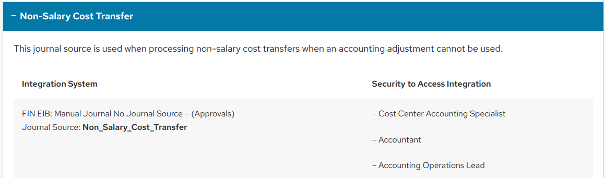
Journal Sources Non-Salary Cost Transfer

Slide 8
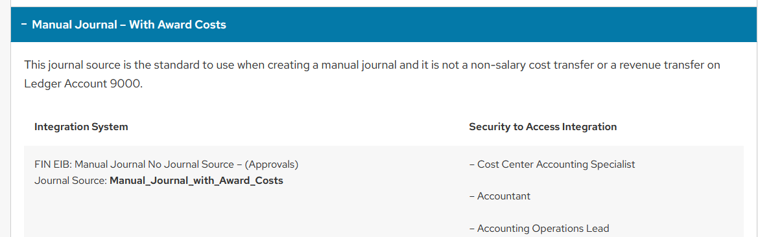
Journal Sources Manual Journal – With Award Costs

Slide 9
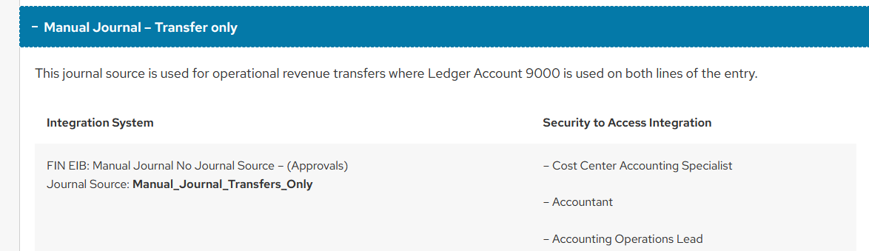
Journal Sources Manual Journal – Transfer only

Slide 10
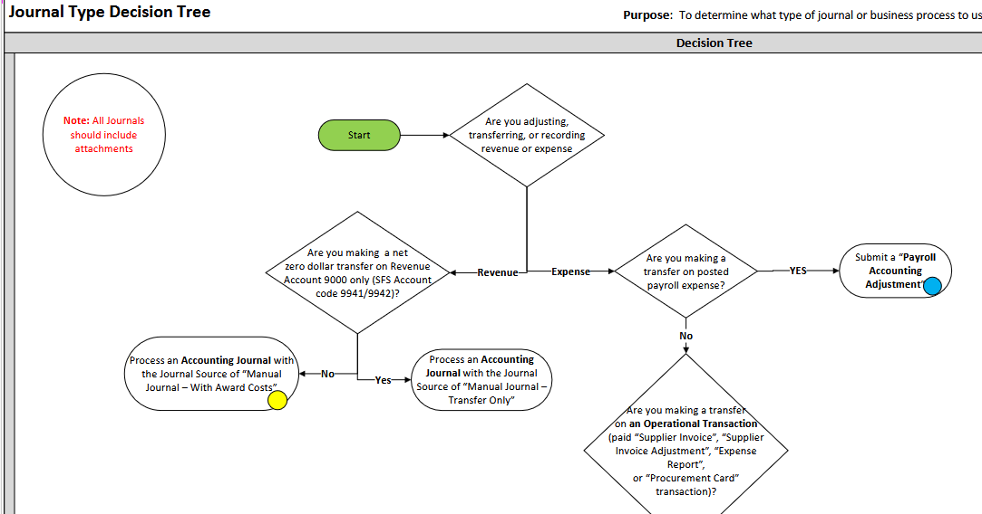
Journal Type Decision Tree
If you are unsure of which journal to submit use the Journal Type Decision Tree
It is too bid to show here, click on the link to view the whole tree.

Slide 11
Create Journal
In Workday

Slide 12
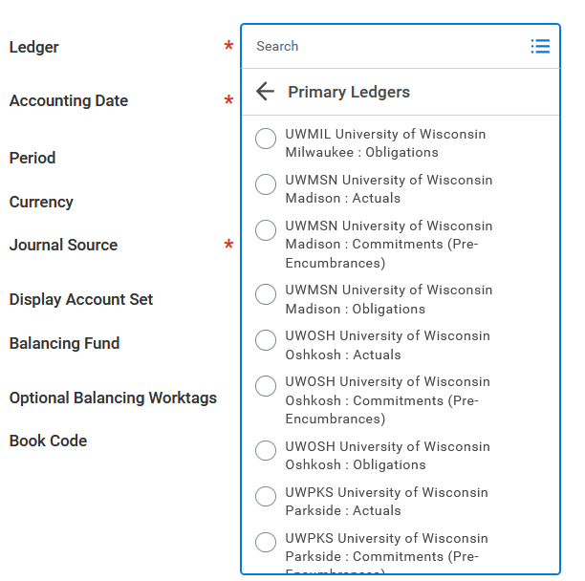
Create Journal
Choose between the UW-Madison Ledgers
This will most times be Actuals

Slide 13
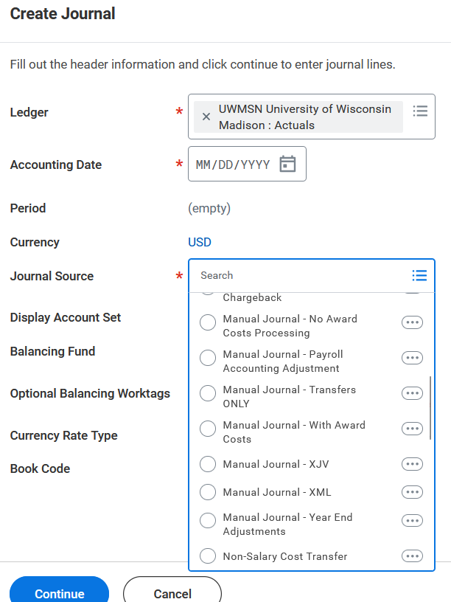
Create Journal
Choose one of the three manual options we reviewed.

Slide 14
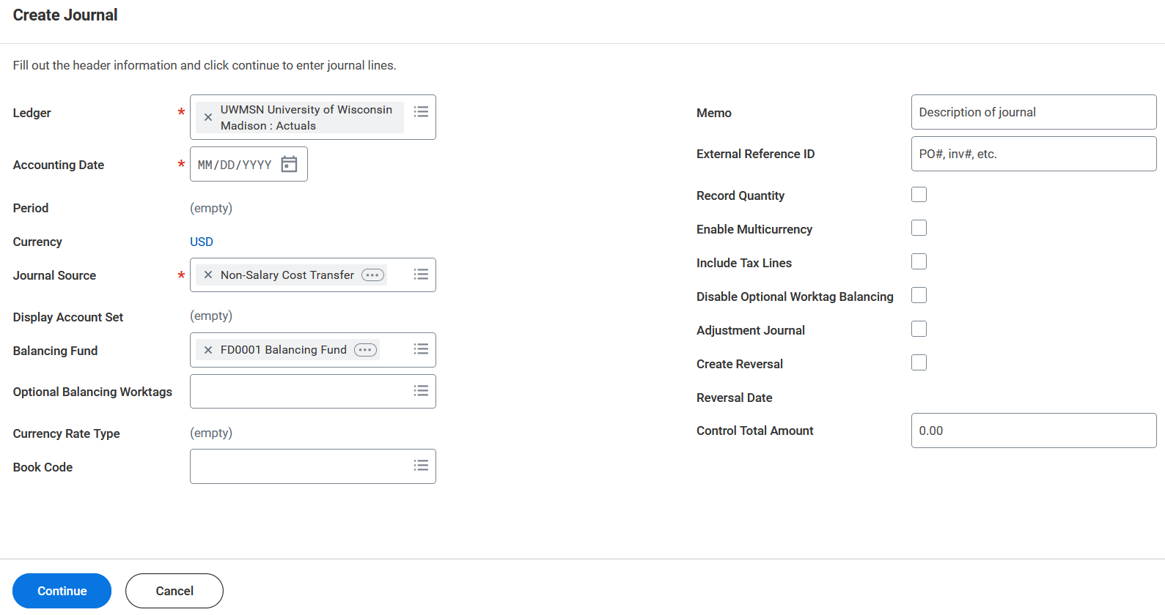






Create Journal
Today’s date
ALWAYS use FD0001

Slide 15
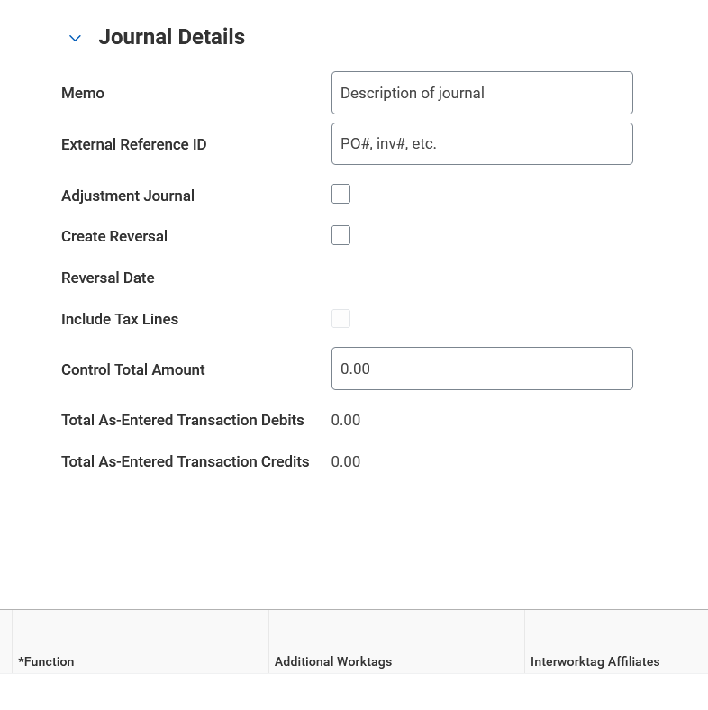
Create Journal
These fields will update as you add amounts to your fields in the journal entry lines. They should balance.

Slide 16
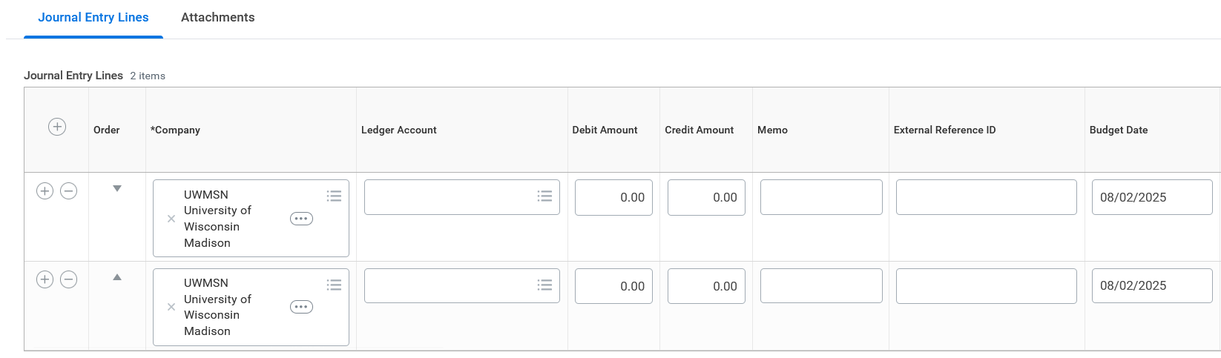




Create Journal
Find the Ledger Account here.
Not required but will help define the transaction in Workday

Slide 17
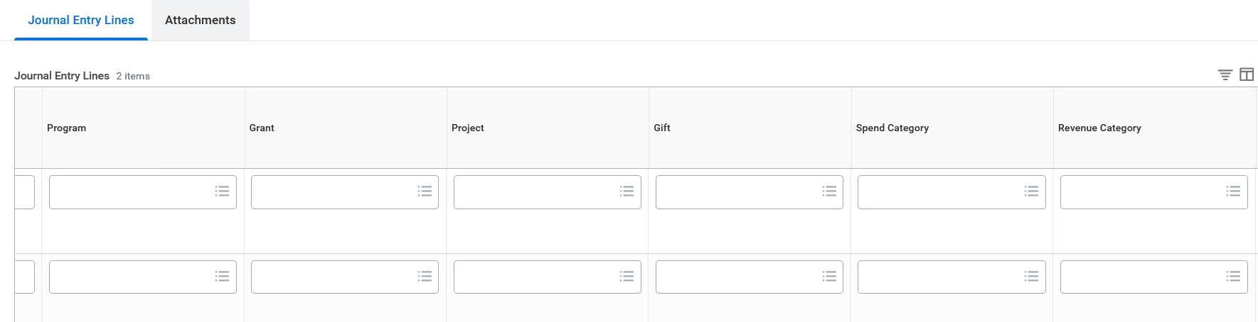
Create Journal
Find the Spend or Revenue Category here.
Worktag in one of these fields

Slide 18
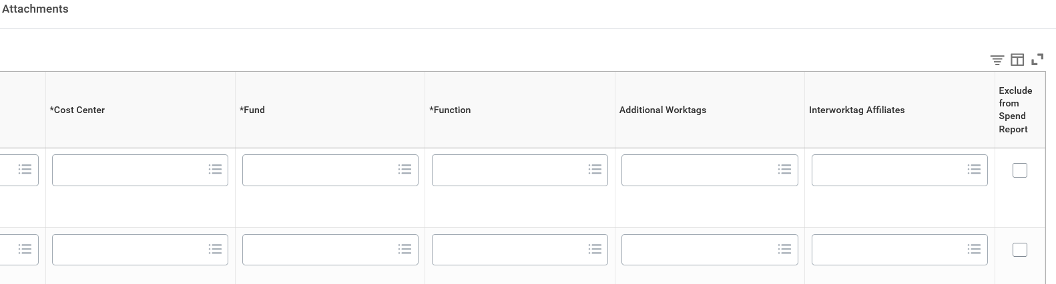
Create Journal
Will auto populate to defaults of worktag. Be sure they are correct.
This is optional and would be an Activity or Expenditure Treatment

Slide 19
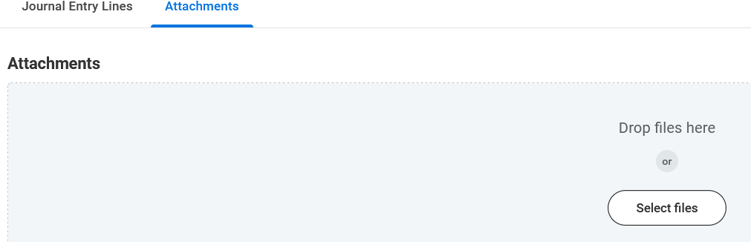
Create Journal
Don’t forget your attachment. If you do forget, you can still add it after you submit.

Slide 20
Add Attachment after Submission

Slide 21
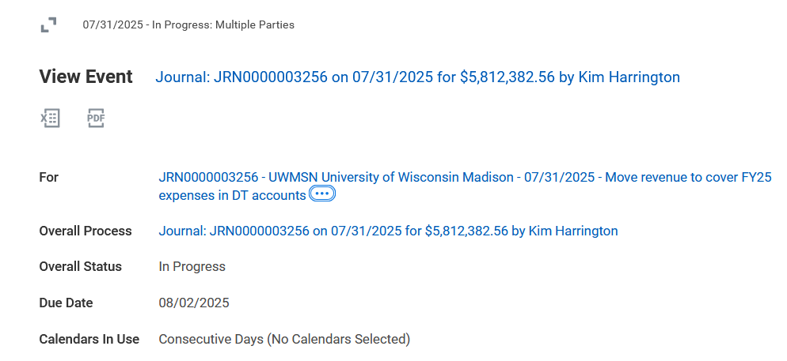
Add Attachment after Submission
(only if not added before submission)
Find your submission in your inbox archive
Click on it so it appears on the right.
Left click on the three dots after the FOR wording.

Slide 22
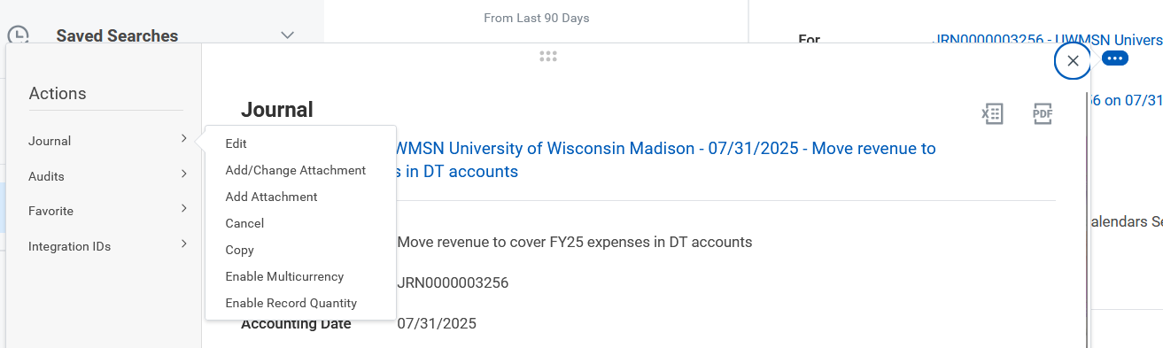


Add Attachment after Submission
(only if not added before submission)
Another window will pop up.
Click on Journal.
Choose Add Attachment.

Slide 23
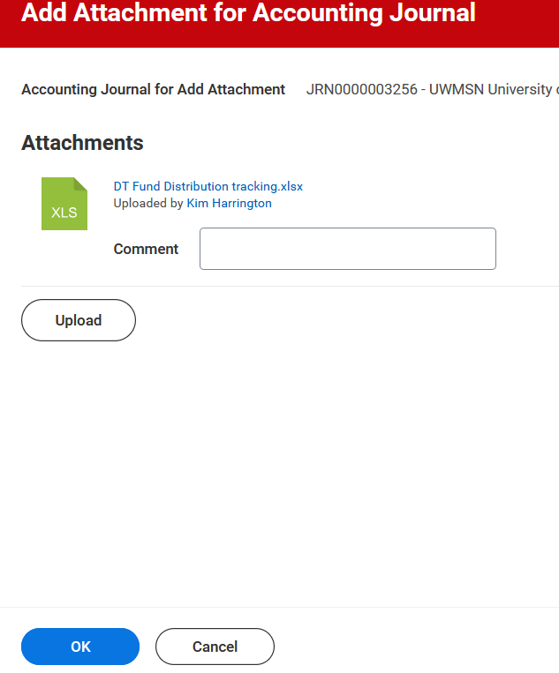
Add Attachment after Submission
(only if not added before submission)
Upload your attachment.
Can also remove attachments.

Slide 24
Enterprise Interface Builder (EIB)
Notes:
STOP

Slide 25
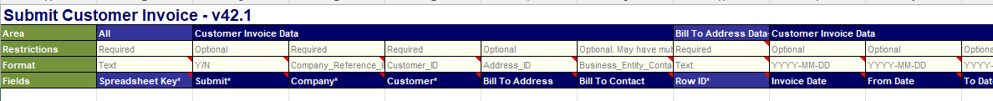
EIB –Enterprise Interface Builder
EIB is a mass upload for several lines
i.e. invoices, customers, contacts, accounting journals
Replaces entering each line individually in Workday
There are different EIBs for different Workday processes

Slide 26
EIB Notes
Columns in the row represent field in Workday
Not all cells have to be filled in
EIB is validated in Workday
When there are no errors then it is uploaded

Slide 27
EIB Assistance
We will have samples on the CoE Workday Intranet for each EIB with the required fields filled in with sample data and highlighted in yellow.
Can’t rely on the “required” in the EIB field headers.
Always download a new EIB from the EIB Library in case there have been any changes.

Slide 28
Accounting Journal EIB

Slide 29
EIB Accounting Journals
AT the time of this training, you should use the EIBs located on the UW-Madison Division of Business Services webpage
UW-Madison Guidance Documents for Creating Journals in Workday
Security Roles for Journal Business Processes
Create Accounting Journal – UW-Madison Specific Job Aid
Example EIB (all manual journals) with UW-Madison Specific Guidance
Temporary EIB File Template (all manual journals) with UW-Madison Specific Guidance
Temporary EIB File Template (all manual journals) – Use to upload into Workday

Slide 30
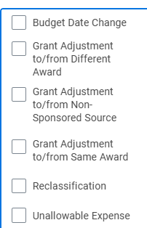
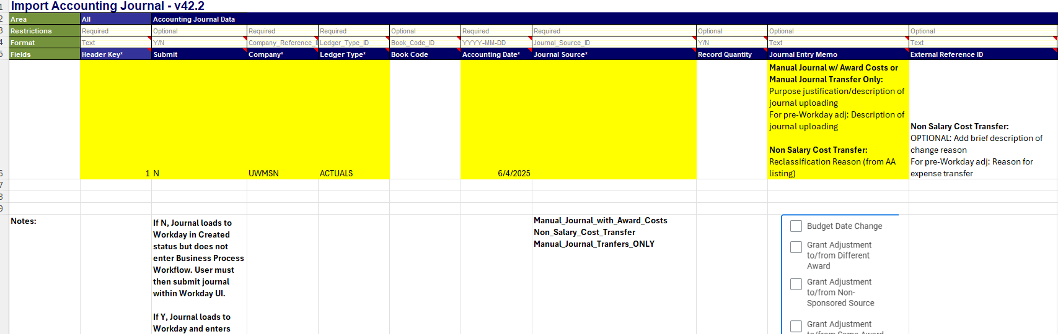
Accounting Journal - Header
Open the EIB guidance file for the Business Services website to assist in filling out.
Use this EIB template when uploading to Workday.
Header tab, fill in:
Header Key (numerical order)
Submit – Y = upload will submit; N = upload need to submit after upload completed
Company – “UWMSN”
Ledger Type – “ACTUALS”
Accounting Date – Today’s Date YYYY-MM-DD
Journal Source – Choose between the three options viewed earlier
Journal Entry Memo: Reclassification reason from list on right
External Reference ID: Reason for expense transfer

Slide 31
Accounting Journal – Journal Lines
For each transfer you will have at least two lines on this tab.
Debits and credits must balance at journal level - leave as whole numbers (do not add in negatives for credit)

Slide 32
Accounting Journal – Journal Lines
On the Journal Entry Line Replacement tab:
Header Key – reference back to header tab
Line Key – Consecutive numbering for lines associated with Header Key line
Line Company – “UWMSN”
Ledger Account – required for each line (DoBS SFS Account Code crosswalk to Workday ledger crosswalk)
Account Set – “CHILD”
Ledger Debit Amount/Ledger Credit Amount – must be balanced, no negatives and whole numbers
Memo - Depends on the type of journal you are submitting
External Reference ID – Tied to documentation from original transaction.
Cost Center
Program/Project/Gift/Grant
Fund
Function
Spend Category – required if expense
Revenue Category – required if revenue
Balancing Worktag Affiliate – ALWAYS FD0001

Slide 33
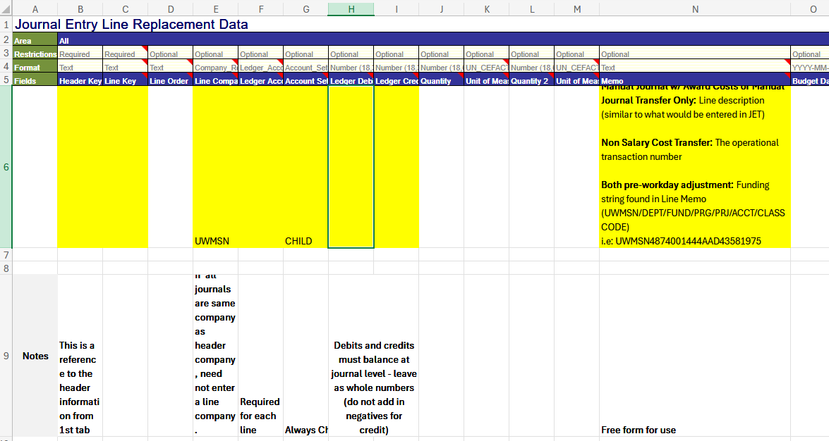
Accounting Journal – Journal Lines

Slide 34
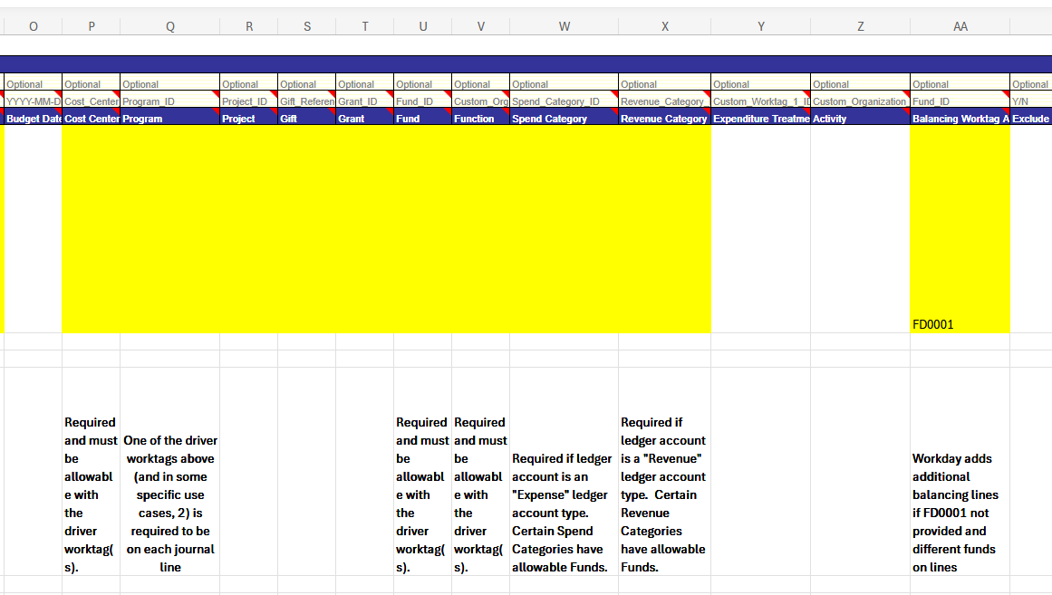
Accounting Journal – Journal Lines

Slide 35
EIB Demonstration

Slide 36
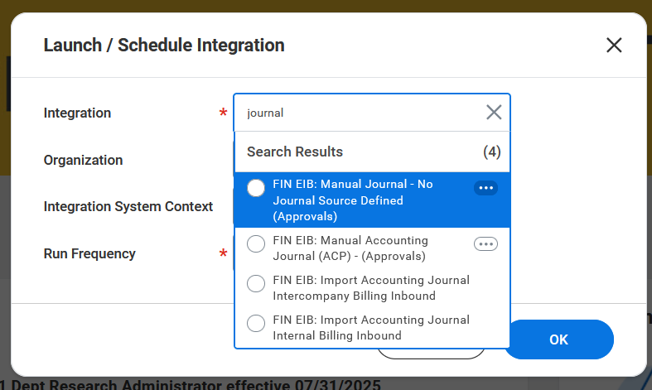
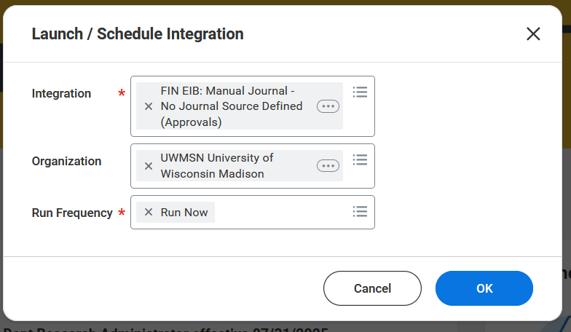
Launch in Workday
Organization is UW-Madison

Slide 37
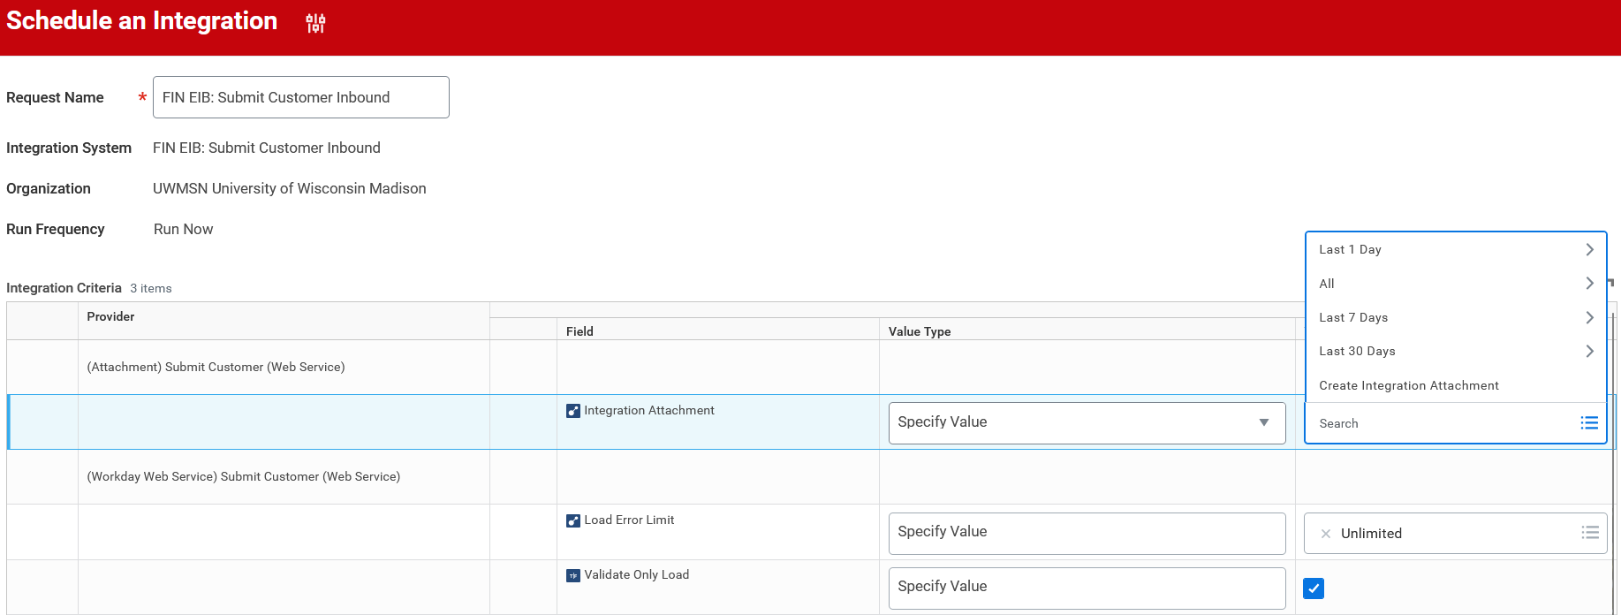


Validate in Workday
Check the highlighted box to validate
Choose Create Integration Attachment
On the page that opens in Workday, upload your EIB
After you upload click ok twice

Slide 38
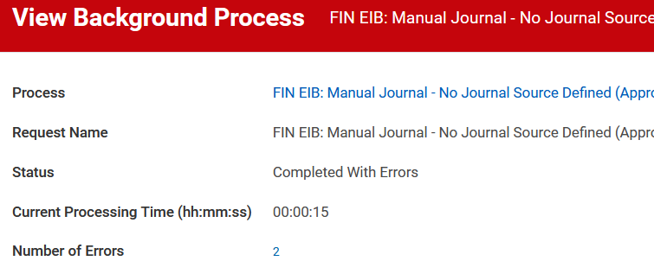
Check for Errors
A process page opens.
Click Refresh until it says completed
It will say completed with errors if there are errors to correct
Click the number of errors

Slide 39
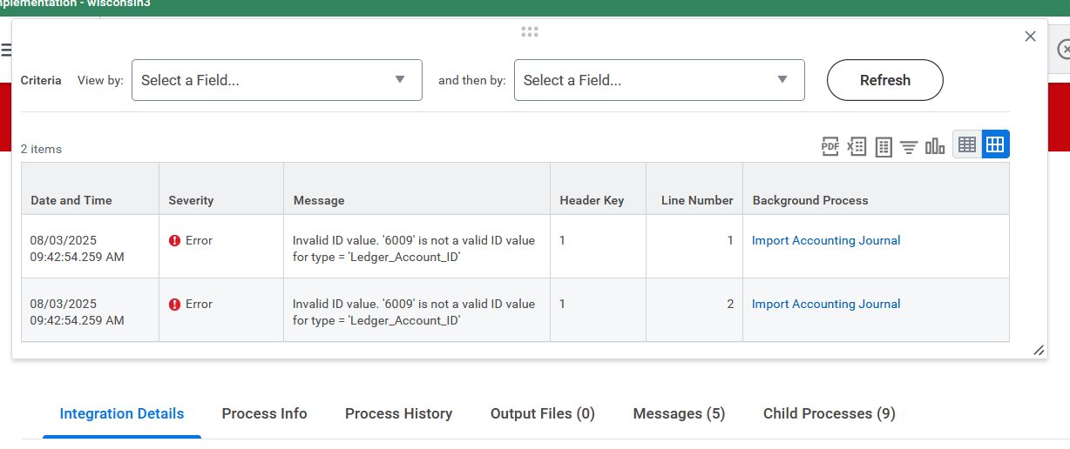
Reviewing Errors
This page will show what your errors are.

Slide 40
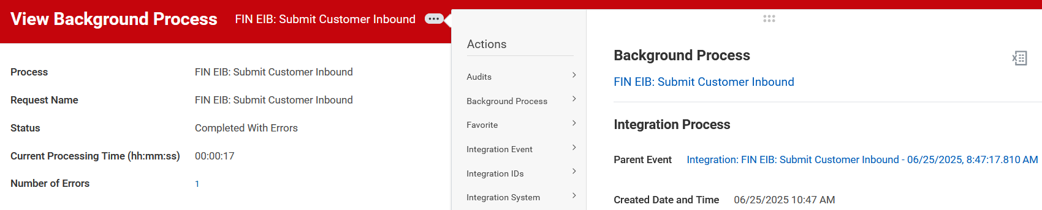

Rerunning Validation
To run the validation again.
Click the three dots by the View Background Process.
Hoover over Integration Event.
Choose Relaunch Integration Event.

Slide 41
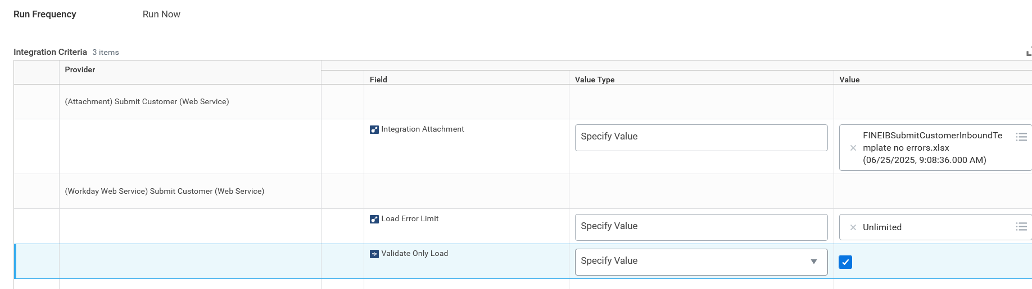


Rerunning Validation and uploading EIB
Remove the file from the page and upload your file again.
Once you have corrected all errors and you are ready to upload the EIB uncheck the box you checked previously.

Slide 42
Draft Upload Submission

Slide 43
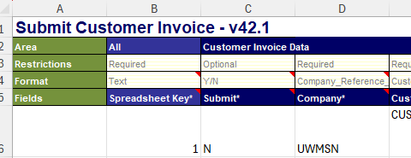


Find Journal Upload
If you choose to not submit your upload it will be in Workday in draft form.
Notes:
This will not be a preferred way because you will have to find each customer and submit the invoices that are in draft form.

Slide 44
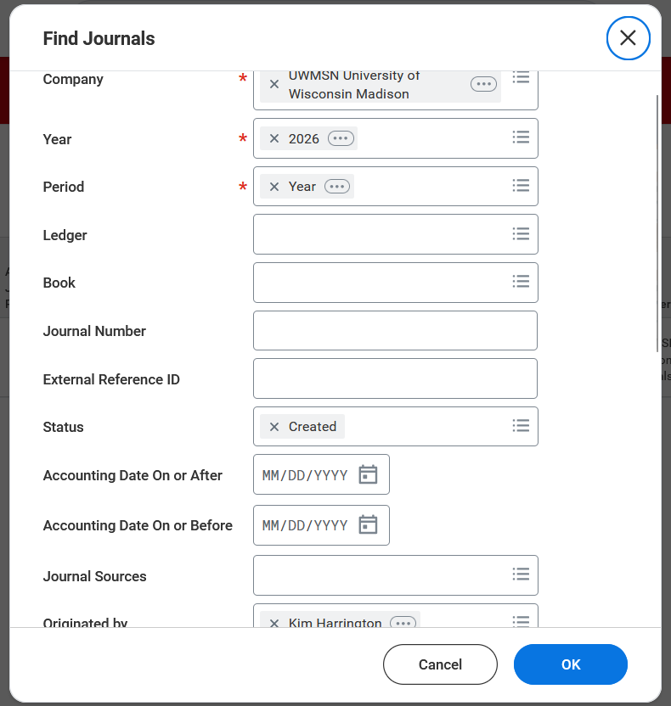
Find Journal Upload
Find Journals
Company = UW-Madison
Year = 2026 (unless for 2025)
Period =
Status = Created
Originated by = Your name

Slide 45
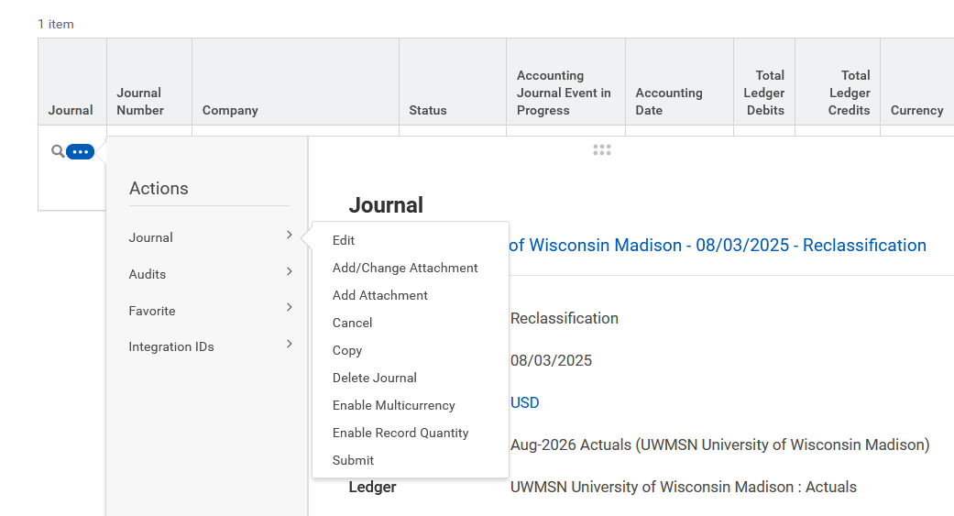
Submit Journal
Three dots next to magnifying glass
Journal under actions
Edit if you want to review and submit Submit if you want to submit from here

Slide 46
Questions

